Slide 1
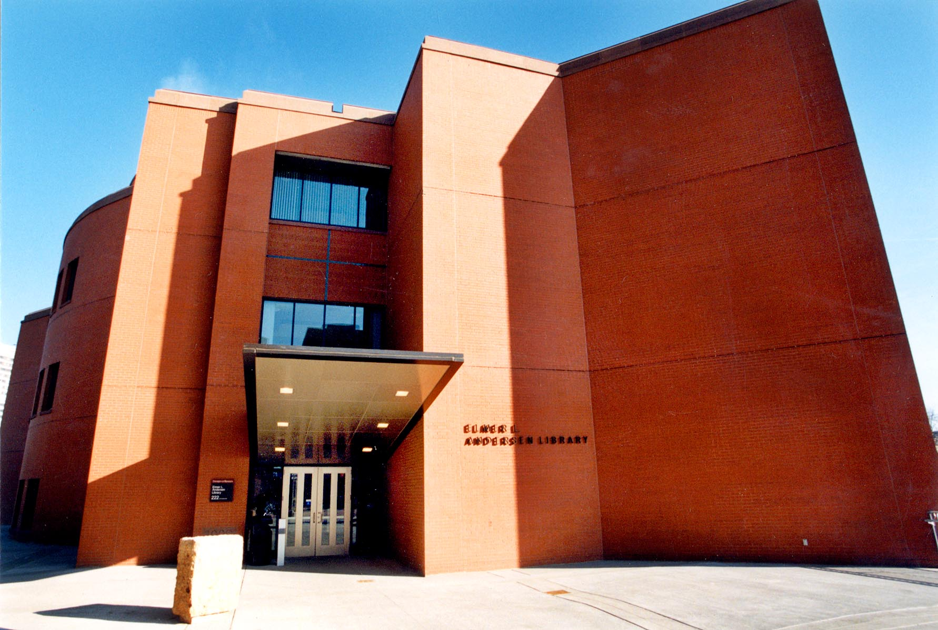
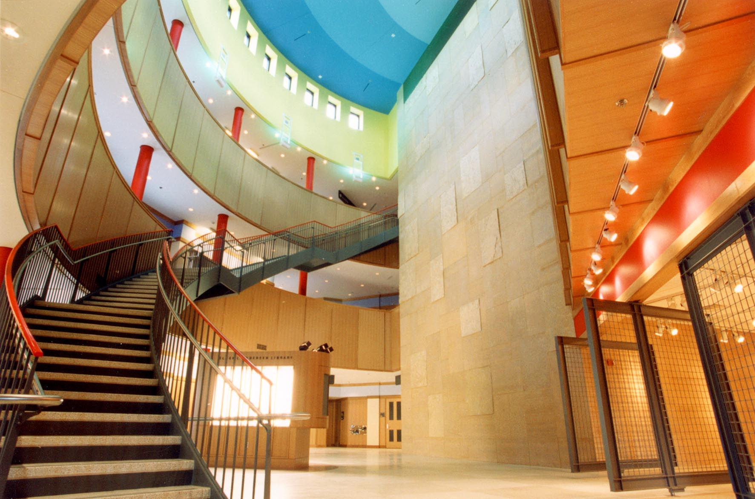
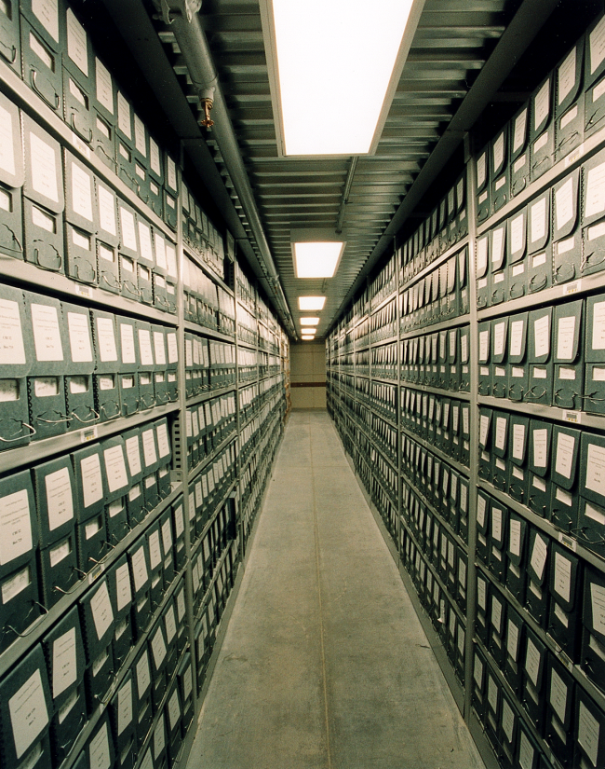
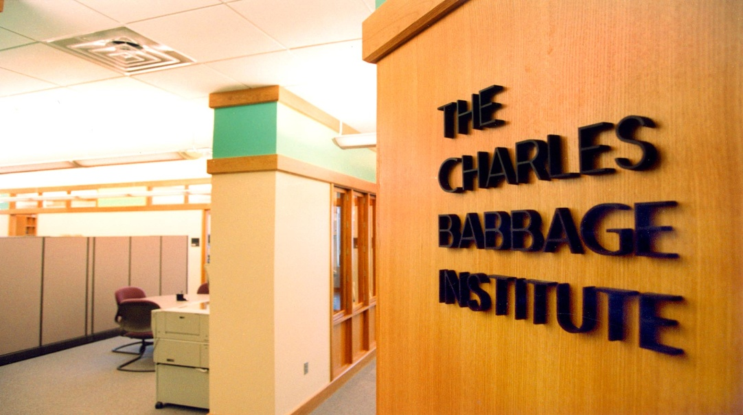
State of Minds: Minnesota’s Pioneering Role in Computing, Networking, and GIS
CBI
Center for the
History of
Information
Technology
Jeffrey R. Yost, CBI Assoc. Director

Slide 2
Charles Babbage Institute Center for the History of Information Technology
-Founded in 1977, first permanent home, University of Minnesota, 1979 (Minnesota, at that time, was arguably the center of the international computer industry)
-Leading research institute on IT history in the world
We write books, articles, conduct sponsored research, etc.
-Leading archive on history of computing/software in the world
-200 collections (Personal papers, corporate records organizational records, photos, etc.)
-More than 400 research-grade oral histories
-More than 5,000 cubic feet of records
-State-of-the-art facilities (Andersen Library)

Slide 3
Minnesota Leadership in Computing Technology and the Pre-PC Computer Industry
Pioneering Technologies/organizations
Stored program computer Internet Gopher
Magnetic drum storage GIS (MapServer, NHGIS, MN GIS/LIS
Supercomputer METROGIS, industry)
Pioneering the Computer Industry
Engineering Research Associates (along w/ Eckert-Mauchly) was the first computer firm in US—both ERA and Eckert-Mauchly Computer Co. founded in 1946.
From ERA to Sperry Univac to Control Data to Cray Research
Also…IBM Rochester (home of the midrange series—including AS/400)
Also...Honeywell

Slide 4
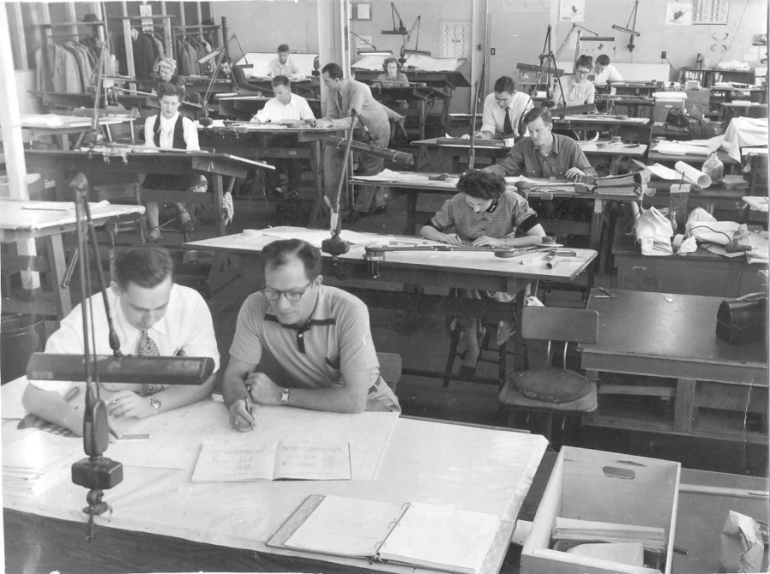
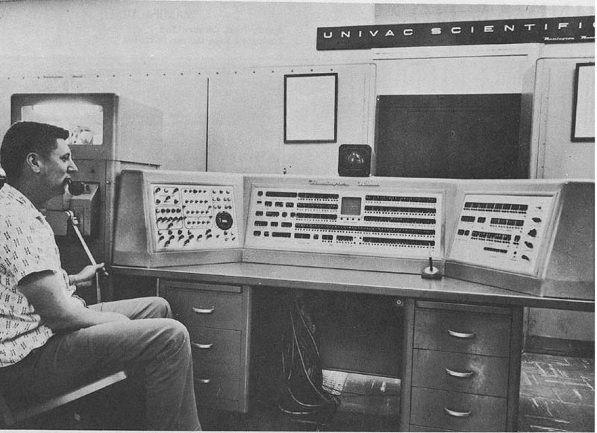
Launching the Computer Industry: Engineering Research Associates (ERA)
Founded in 1946 by small group of U.S. Navy code breakers (and investor John Parker)
-Initially in a St. Paul Aircraft Hanger
-1950 Atlas computer for DoD (commercialized as ERA 1101)
[a year before Eckert-Mauchly/Remington Rand’s Univac]
ERA engineers and other staff, circa 1950
ERA 1101

Slide 5
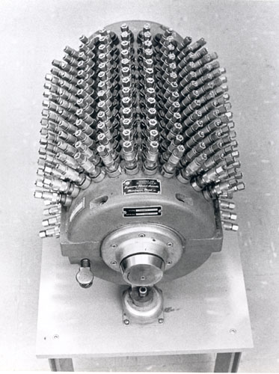
ERA Technological Firsts
ERA Atlas among the first stored program computers
1948-Manchester Baby
1949-Cambridge Univ. EDSAC
1950-Half dozen one-of-a kind machines in US (Atlas, SWAC, SEAC….)
ERA 1101 was the first commercial (multiple units produced) stored program computer
ERA world leader in magnetic drums (storage)
ERA Physicist Dr. Sidney Rubens
ERA magnetic drum, 1950

Slide 6
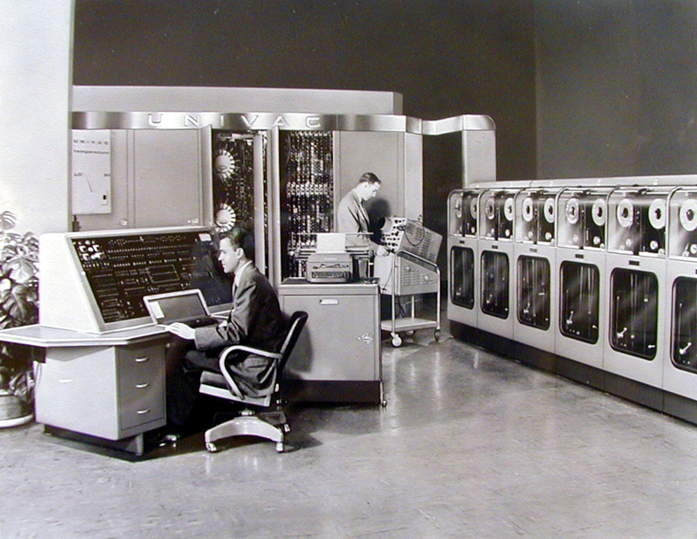
Remington Rand, Sperry Rand, and Sperry Univac
Office machine firm Remington Rand takes over Eckert-Mauchly Computer Co. in 1950 and Remington Rand takes over ERA in 1952
The Minneapolis-St. Paul operation (ERA) and Philadelphia operation (Eckert-Mauchly) make up Remington Rand’s computer division
In 1955 Remington Rand and Sperry Corporation merge and Sperry Univac formed
Integration was difficult for Sperry Univac and conflicts were frequent between Minneapolis and Philadelphia operations of Sperry Univac
Univac I (1951)

Slide 7
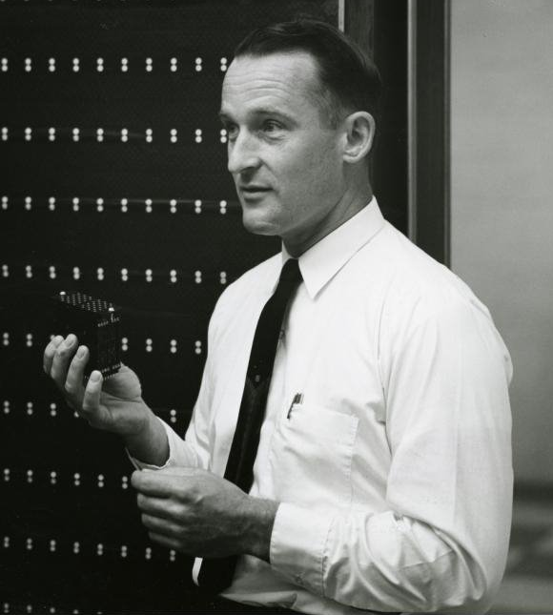
Control Data Corporation
Formed by several defecting Minneapolis-based Sperry Univac managers and engineers in 1957
-Co-founder of ERA William Norris, co-founded CDC and was unanimous choice as CEO and ran the firm for 3 decades
-Sperry Univac’s Seymour Cray became CDC’s chief design engineer
William Norris
Seymour Cray

Slide 8
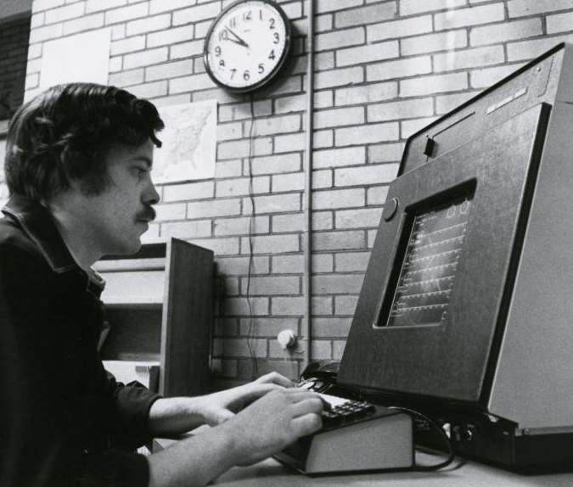
Control Data Corporation Technologies
-CDC 1604 (1960) 48-bit
-CDC 6600 (1964) First Supercomputer (3X faster than IBM Stretch)
-PLATO –computers for education (K-12, higher-educ., prisons…..)
Inmate at Stillwater , Minnesota Prison using PLATO terminal (mid-1970s).
CDC 6600

Slide 9
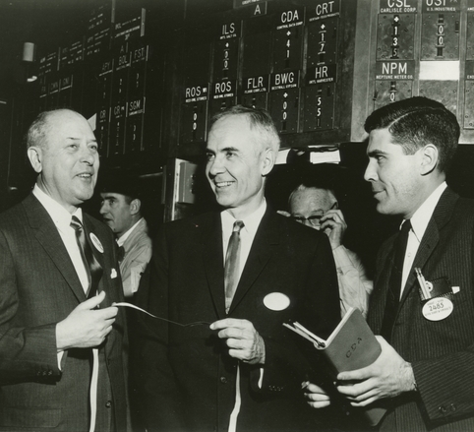
Late 1960s and 1970s CDC #2 (to IBM) in the Computer Industry (CDC is 1st in Supercomputing)
CDC Revenue
1962 $41M
1967 $245M
1969 $1.02B
1972 $1.2B
1977 $2.3B
1982 $3.2B
March 6, 1963
Control Data
Corporation listed on the NYSE

Slide 10
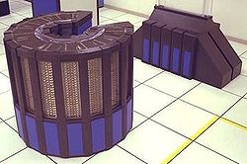
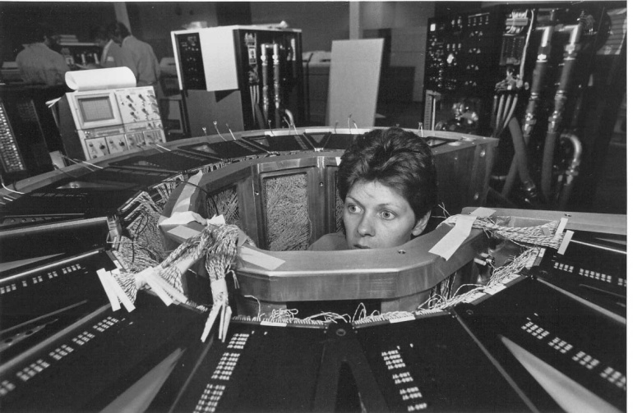
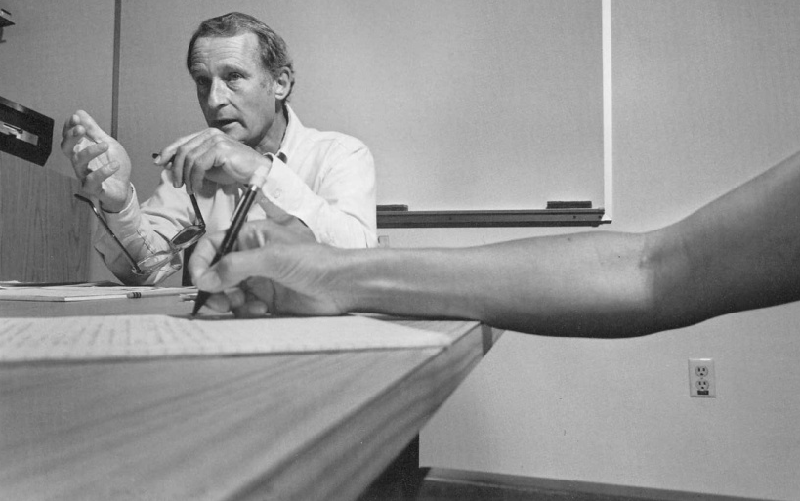
Cray Research
Seymour Cray leaves CDC in 1972 to form Cray Research, Inc. (HQ Minneapolis)
Cray Research displaces CDC as supercomputer leader
Cray Research takes over the lead in supercomputing with Cray I (1976), and furthers its lead with Cray X-MP (1983) and Cray II (1985) supercomputers.
Cray Research founder and CEO Seymour Cray
Cray I
Cray II

Slide 11
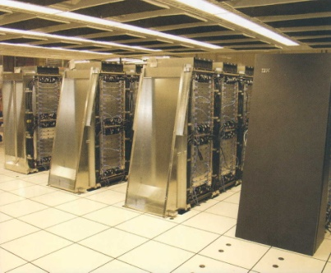
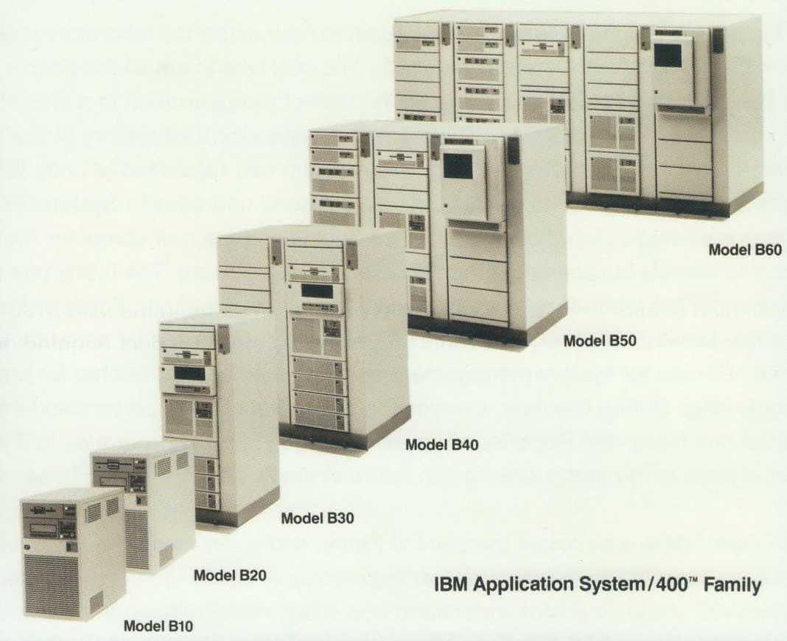
IBM Rochester (MN)
-Founded in 1956 as a new manufacturing facility IBM added a development lab in Rochester in 1961
-Not just another IBM facility—home of the design, development and manufacturing of IBM’s midrange series (minicomputers)--System 3 in 1969 to the AS/400 in 1988 to powerful servers and supercomputers in the 2000s
-AS/400 family alone brings in $14B in revenue in 1990, more than the second largest computer maker (Digital Equipment Corporation’s) entire revenue. (Source: Datamation)
IBM BlueGene/L
(2005 LLNL)

Slide 12
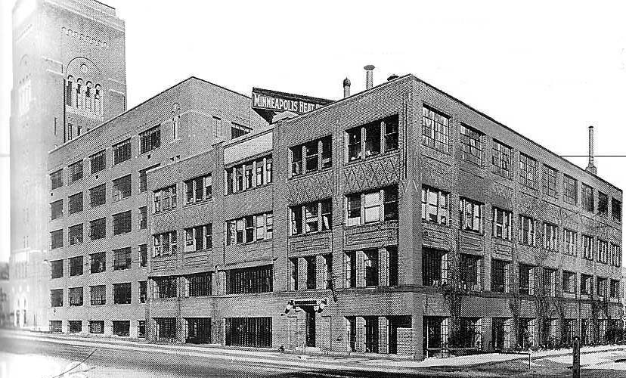
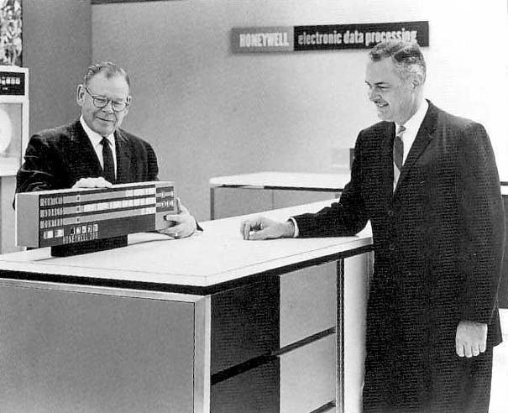
Honeywell
-Founded 1883 in Wabash, Indiana
-Minneapolis Honeywell Regulator (1927--becomes corporate HQ)
-Emerges as defense, aerospace, control system conglomerate in WWII and beyond
-Longtime leader in aviation navigation technology/industry
Honeywell (Computing Div.)
1955-Joint venture with Raytheon
(but Honeywell soon buys out
Raytheon’s stake)
1958-Honeywell 800 launched
1963-Honewell 200 (competes w/IBM 1401)
1970-Honeywell buys GE computer div.
1991-Honeywell sells to Groupe Bull
(leading French computer manuf.)

Slide 13
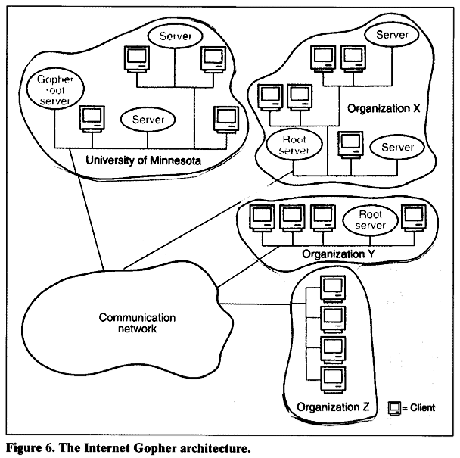
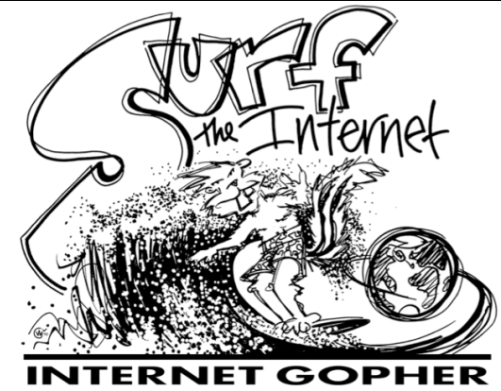
Internet Gopher
-Gopher project begins in 1989, led by Mark McCahill
(also led project for POPmail, late 1980s popular
email client, FormsNirvana, etc.)
-Gopher deployed in 1991
(Same year as Berners-Lee WWW,
but predated NCSA’s Mosaic by 2 years)
-What (was)is Gopher?
-hyperlinked, hierarchical, menu-based,
text-based system for using internet
-U of M plans for fees for servers
-Used by only a small group of enthusiasts
after graphics-based, free Netscape
available in 1994
Mark McCahill

Slide 14
GIS
Fundamental contributions from departments and centers at the University of Minnesota, as well as by government and industry
A sample of important highlights of Minnesota contributions:
-Mapserver
-NHGIS
-MetroGIS
-MNGIS/LIS
-Industry (From small enterprises, like Airborne Data Systems of Redwood Falls, MN, to U of M alum and ESRI founder Jack Dangermind)

Slide 15
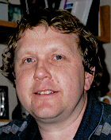
MapServer
-1994 University of Minnesota Department of Forestry Resources professor Thomas Burk launches project to support web-delivery of forestry data (Partnership between the Univ. of Minnesota and the Minnesota Department of Natural Resources). Project receive NASA funding .
-Evolves into a highly influential open-source development environment for spatial internet applications
-Becomes part of Open Source Geospatial Foundation, a nonprofit NGO formed 2006
-30,000 websites using this software
U of M’s Thomas Burk

Slide 16
NHGIS
A product of the interdisciplinary Minnesota Population Center at the University of Minnesota
National Historical Geographical Information System (NHGIS) provides free aggregate census and GIS-compatible boundary files for U.S. from 1790 to 2000.
NHGIS created by a research team led by Univ. of MN Geography Dept. faculty members Robert McMaster, John Adams, and Mark Lindberg in partnership with Steve Ruggles from the Minnesota Population Center (received $5 million in funding from NSF).
Robert McMaster
Steven Ruggles

Slide 17
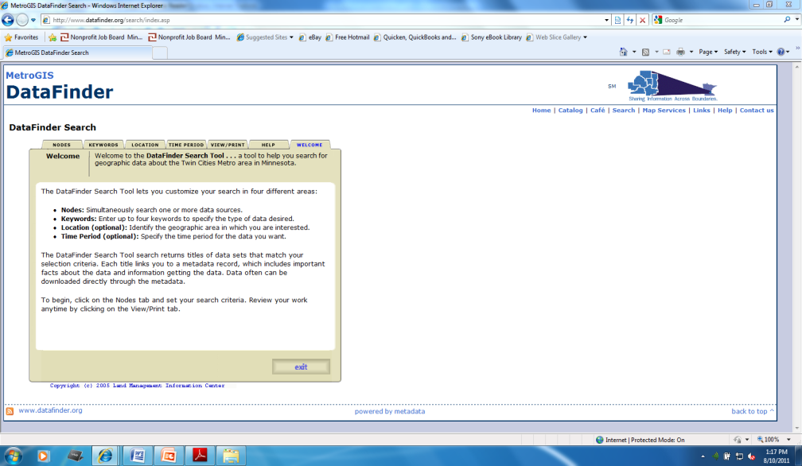
MetroGIS
-Established in 1995 and sponsored primarily by the Metropolitan Council
-Foster collaboration and cooperation of Twin Cities metro area organizations that use GIS to carry out functions—designed to promote efficiencies and effectiveness with sharing accurate geospatial data
-Primary stakeholders include the Metropolitan Council, state counties (seven in Twin Cities metro), school districts, water management organizations, as well as state and federal agencies.
MetroGIS’s facilitates a culture of data sharing through its data access tool, DataFinder

Slide 18
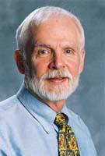
Minnesota GIS/LIS
-Formed in 1988 (originally as MN NRGIS), GIS/LIS was one of the first forums nationwide to focus on communication and information sharing in the natural resources GIS community
-Partnering organizations include the Department of Natural Resource (DNR), Land Management Information Center (LMIC), the University of Minnesota’s Center for Urban Regional Affairs (CURA) and the Natural Resource Research Institute
-One of the most active consortia of its kind, it serves as a model for such organizations throughout the nation
Will Craig
CURA Assoc. Dir.

Slide 19
Industry
From modest-sized Minnesota GIS firms, to educating future leaders of GIS giant corporations, Minnesota has had a profound impact on the national and internal GIS industry
Airborne Data Systems of Redwood Falls, Minnesota (small company run by David Fuhr, a pilot who flew reconnaissance missions during the Vietnam War).
-Hired by British Petroleum to chart the Gulf oil spill with high resolution aerial photos
-Other applications—studying flood damage in the Red River Valley, patrolling US borders, etc.
Esri—GIS software giant whose president Jack Dangermond is an alum of the University of Minnesota (M.S., Environmental Science)
-Founded in 1969, this software products and services GIS firm has roughly 30 percent market share in the GIS software industry

Slide 20
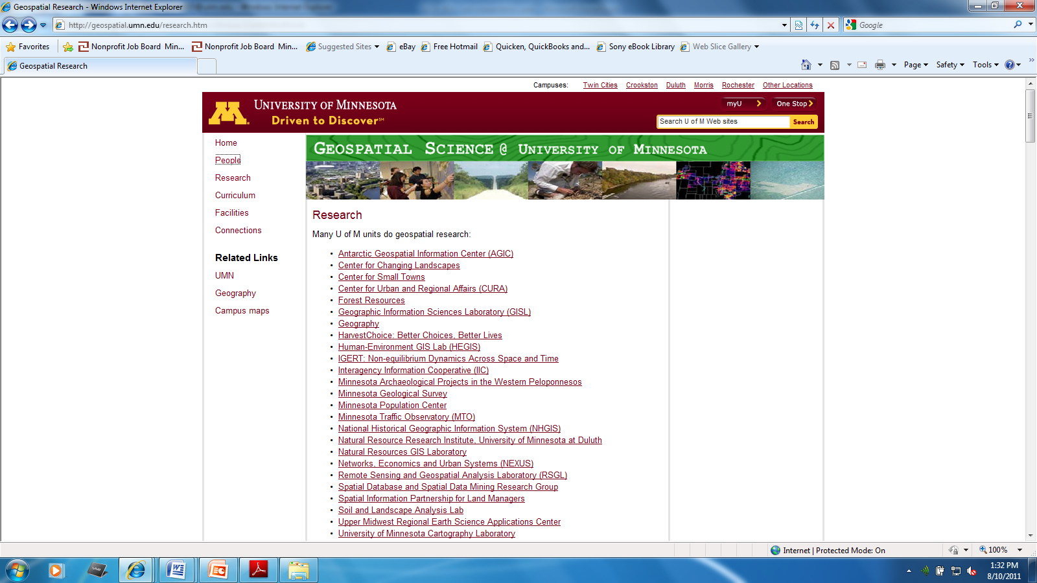
Geospatial Science @ UMN
Many departments, centers, and scholars across the campus, and the UMN system contribute to advancing geospatial science.

