Slide 1
Finding Top-k Shortest Path Distance Changes in an Evolutionary Network
Manish Gupta
UIUC
Charu Aggarwal
IBM
Jiawei Han
UIUC
SSTD 2011
24th August 2011

Slide 5
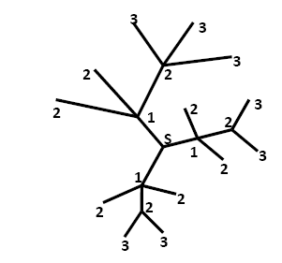

Slide 6
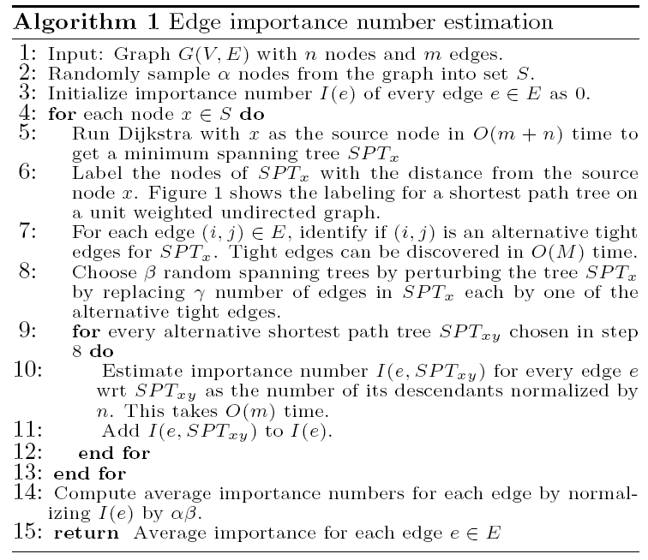

Slide 7
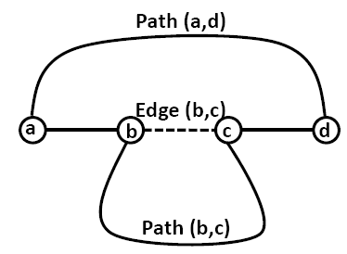

Slide 8
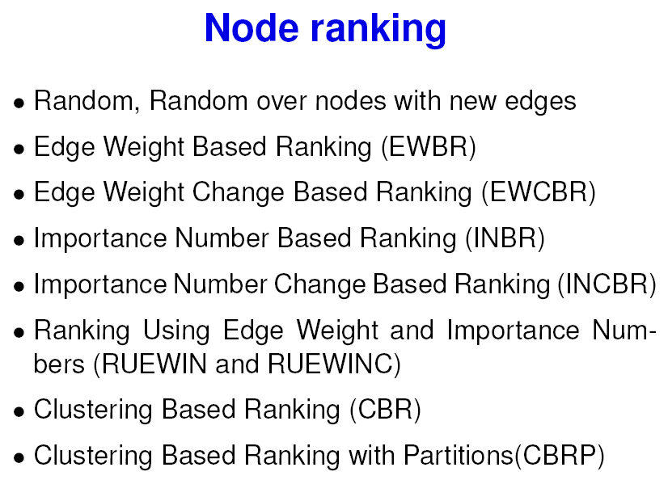

Slide 9
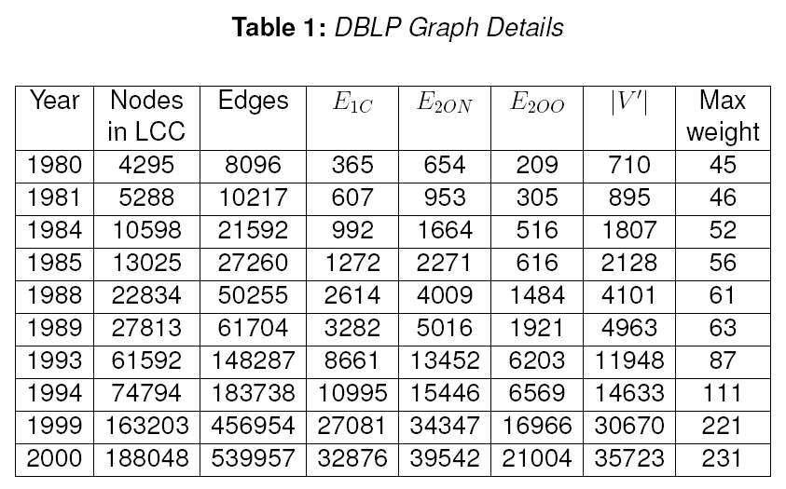

Slide 10
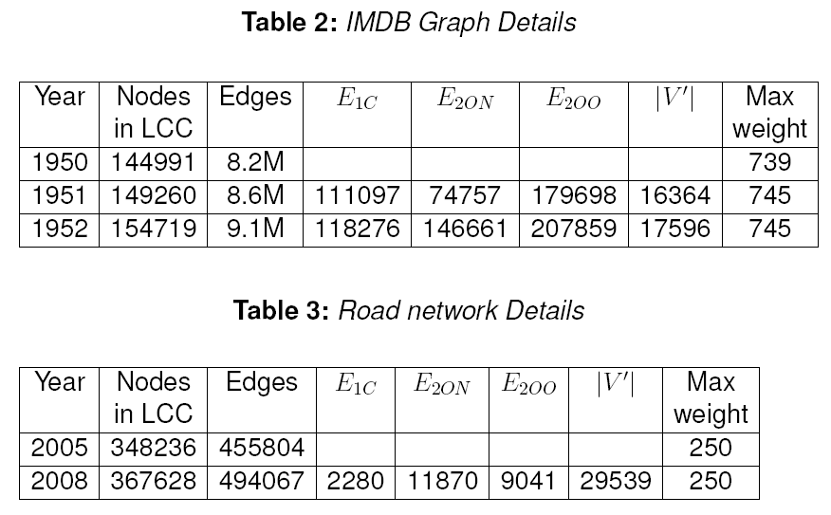

Slide 12
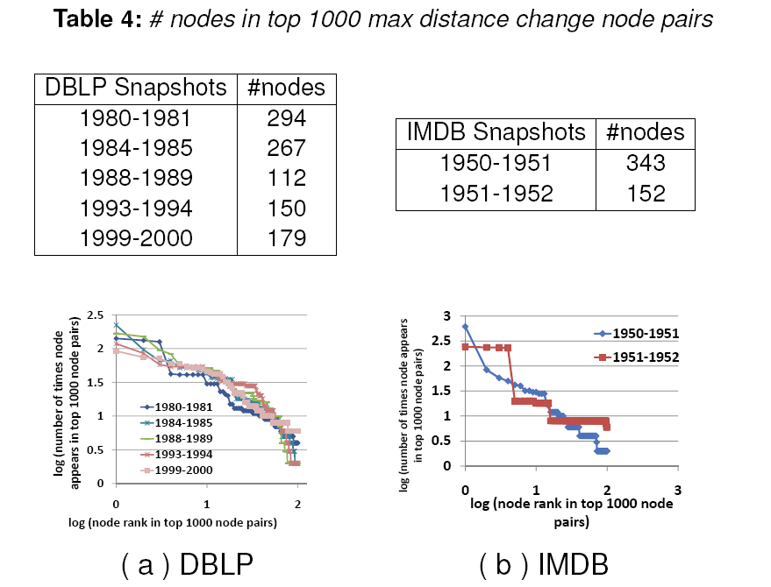

Slide 13
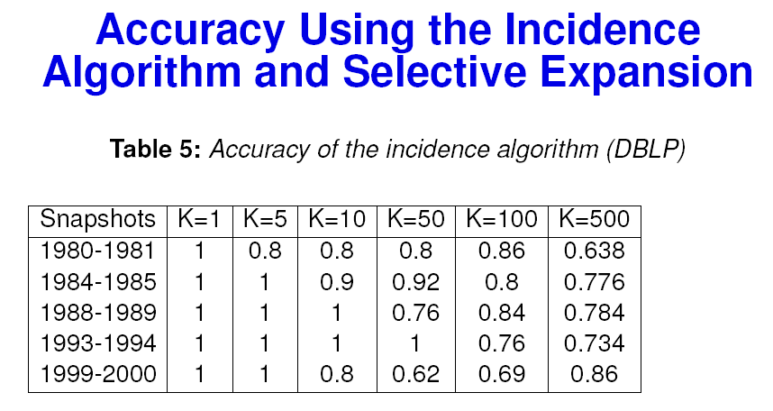

Slide 14
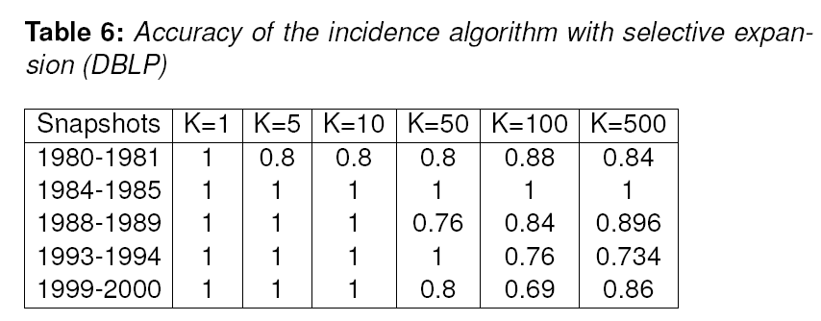

Slide 15
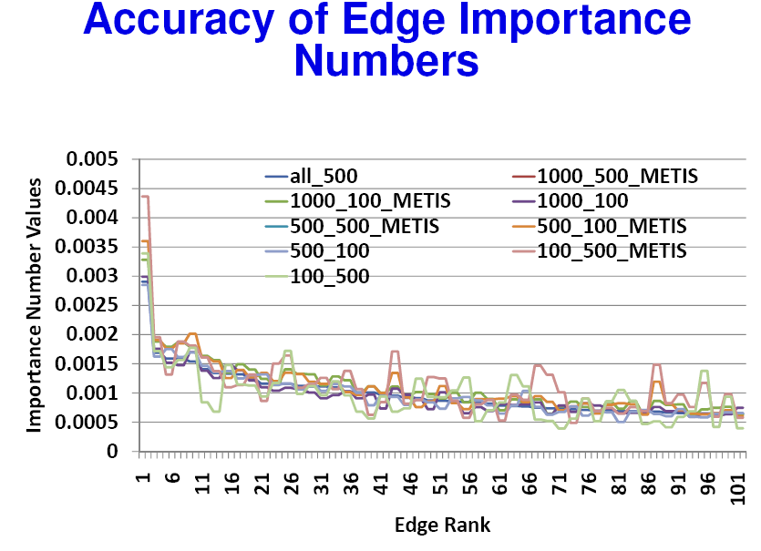

Slide 16
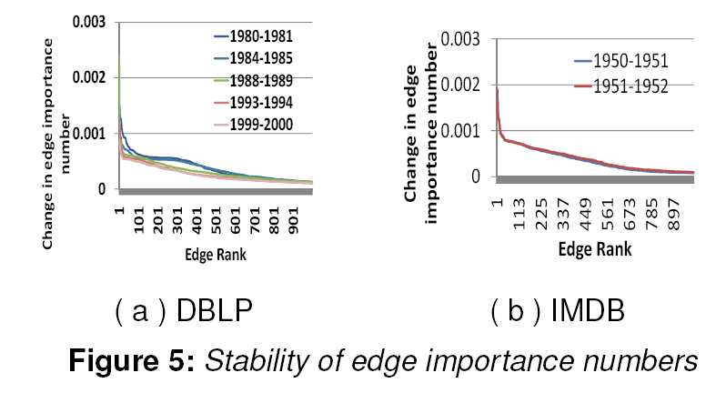

Slide 18
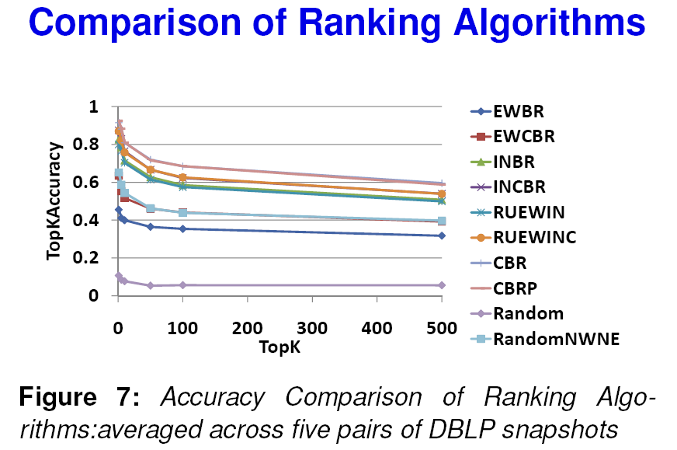

Slide 19
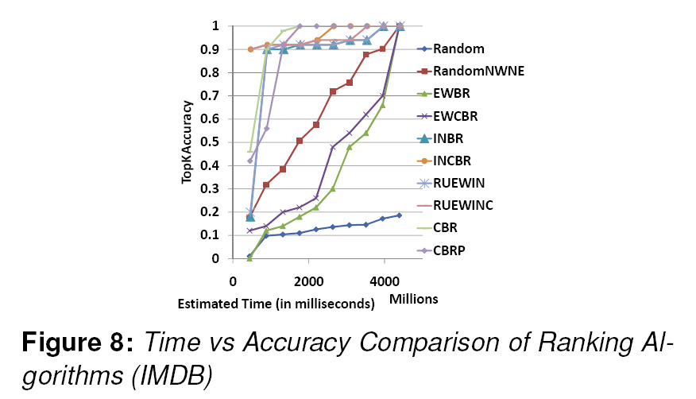

Slide 20
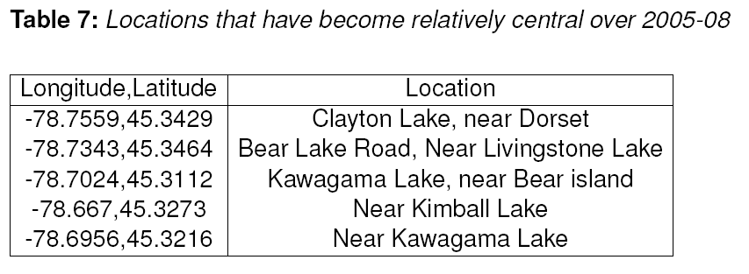
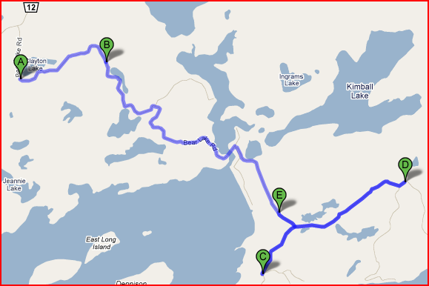

Slide 21
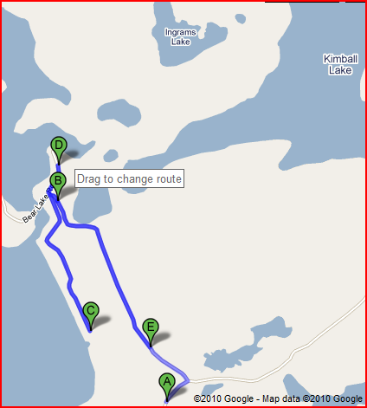
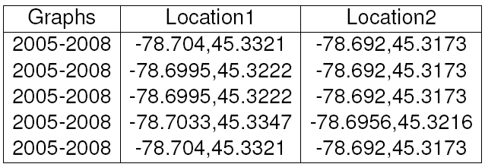

Slide 22
Related work
Shortest path algorithms: Dijkstra [11], Shimbel [20], Johnson [15], Floyd, Warshall [14,21]
Router networks [8,22]
Outlier detection [5,13,18]
Time dependent shortest paths [25,26]
Dynamic shortest paths computation [3,4,6,19]
Between-ness measures [23,24]

Slide 24
References

Slide 25
References

Slide 26
References

Slide 27
Thanks

