Slide 1

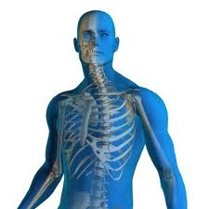


From Geography to Medicine: Exploring Innerspace via Spatial and Temporal Databases
Dev Oliver¹
Daniel J. Steinberger²
¹Department of Computer Science and Engineering, University of Minnesota, USA
²Department of Radiology, Medical School, University of Minnesota, USA

Slide 2
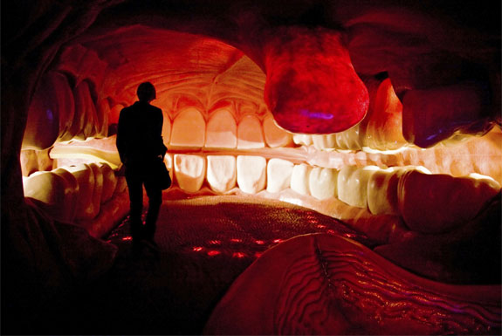
Outline
Motivation
Vision
Challenges
http://travel.spotcoolstuff.com/unusual-museum/amsterdam/corpus-human-body

Slide 3
Motivation (1/2)
Improve healthcare quality
  Deliver the correct diagnosis
  Simplify tracking of disease and determine response to therapy
  Reduce healthcare expenses
Medical imaging growing disproportionately
  Large amounts of Spatial and Temporal data
Source: CDC, Health, United States, 2009 In Brief

Slide 4
Motivation (2/2)
10 year Medical Imaging Debacle: The $1 Trillion freight train (no growth)
© 2010 Daniel Steinberger

Slide 5
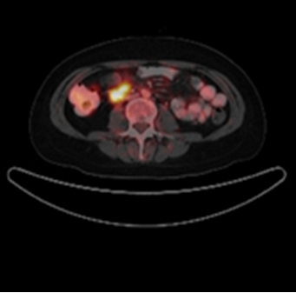
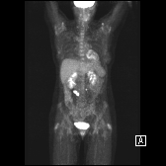
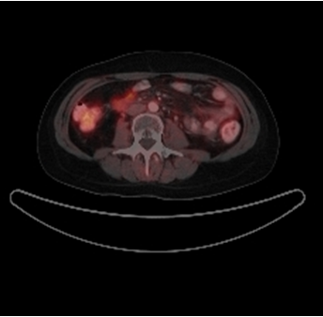
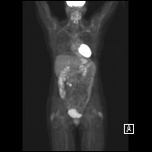
Example: Tracking Legions Over Time
Before Treatment
After Treatment

Slide 6
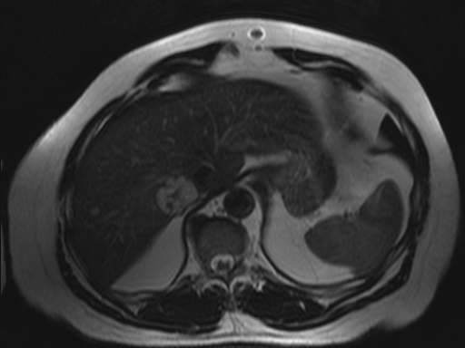
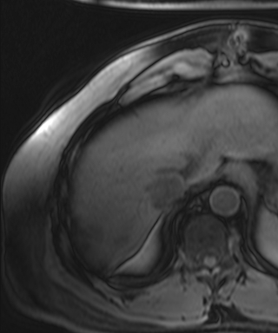
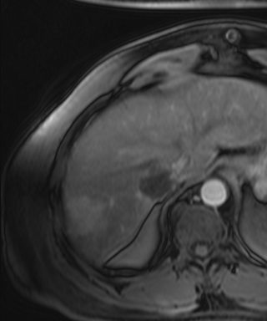
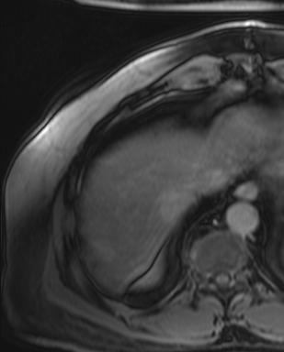
Example: Change detection in a single visit
Single exam reveals several legions over
multiple sequences
Before
Immediately After
10 Minutes After

Slide 7
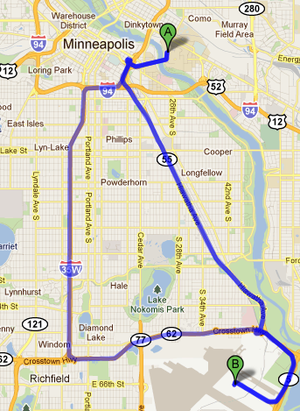
Spatial and Temporal Databases
Useful for longitudinal study
  Monitoring
    How is a crime hotspot spreading/shrinking over time?
    What are the recurring changes in the environment?
  Predictive
    Which counties have emerging cancer clusters?
  Routing
    What is the best route from DTC to MSP during rush hour/non rush hour?
http://maps.google.com/

Slide 8
How may Spatial and Temporal Databases help Medicine?
Vision: A spatial-temporal framework for longitudinal study in which crucial monitoring, predictive, and routing questions may be answered algorithmically
  Monitoring
    How is a cancerous growth spreading/shrinking over time?
    Have blood vessels narrowed past a certain threshold?
    What are the emerging symptoms in a patient?
  Predictive
    How can the therapy effect on tumors across a population be used as a guide for future therapies?
    What are the long term and short term trends in a patient’s liver panel test results? What are the exceptions to the long term trend?
    When will a patient develop coronary artery disease?
  Routing
    What is the best route for minimally invasive surgery to remove a tumor?
    Which route for precision surgery tools minimizes damage to blood vessels?
    What is the best route to deliver life-saving medicine?

Slide 9
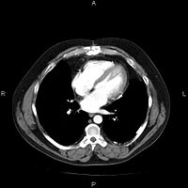
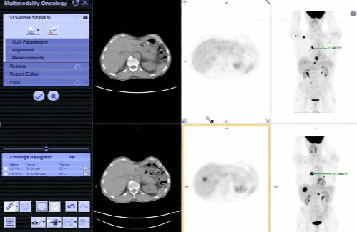
Related Work (1/2)
Picture archiving and communication systems (PACS)
  Economical storage and convenient access to images from multiple machine types
Commercially available advanced image processing tools (e.g., Siemens VIA, Leonardo)
  Find and measure lesions on previous studies
  Determine if there has been relative mass loss in certain parts of the brain
An image as stored on a PACS¹
¹http://en.wikipedia.org/wiki/Picture_archiving_and_communication_system

Slide 10
Related Work (2/2)
Limited exploratory, associative and predictive analysis capabilities
  Exploratory
    Enable user to construct completely new queries on the data set (beyond a fixed list of canned queries)
  Predictive
    Use time series of snapshots to determine future behavior using data driven techniques
  Associative
    Correlate patient’s history and context (e.g., age, race, co-morbidities)
Largely based on raster data model (e.g., pixel, voxel)
  Inadequate support for vector data models (e.g., points, line strings, polygons, networks) and queries (e.g., topological operations, shortest path, etc.)
No general frame of reference similar to geographic-based latitude/longitude or postal addresses

Slide 11
Challenges
A reference frame analogous to latitude/longitude must be developed for the human body
  Stereotactic surgery
Location determination methods are needed to know where we are in the body
  Remote telesurgical operation using surgical robots
Routing in a continuous space while reducing the invasiveness of certain procedures
  Deliver life-saving cancer-killing chemicals to brain tumors
Defining and capturing change across two images is crucial for understanding trends
  When will an infection metastasize?
Scalability to potential Petabyte and Exabyte-sized data sets
  Medical images captured more frequently for more people
Real-time mapping, change detection, and routing
  Change route to tumor on detection of unmapped blood vessel

Slide 12
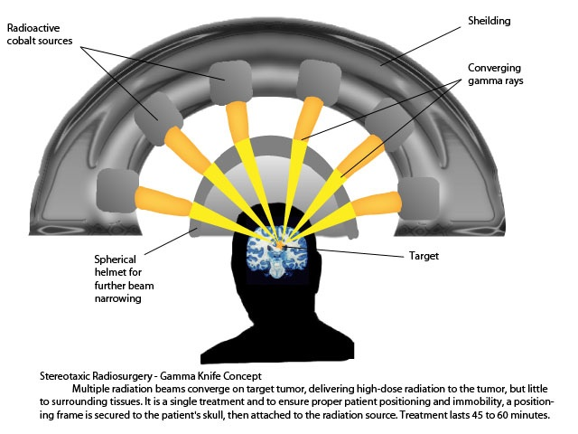
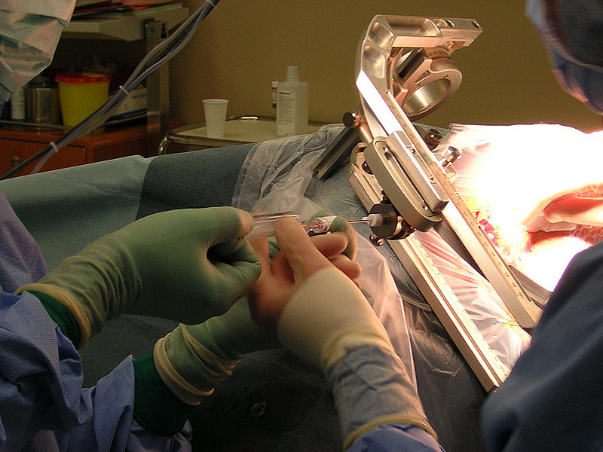
Challenge 1: Reference frame for the human body (1/2)
Define coordinate systems to facilitate looking across snapshots
Rigid structures may provide clues on current spatial location
  Used in Stereotactic surgery to locate small targets in the body for biopsy, injection, etc.
http://en.wikipedia.org/wiki/Stereotactic_surgery
http://en.wikipedia.org/wiki/Stereotactic_surgery

Slide 13
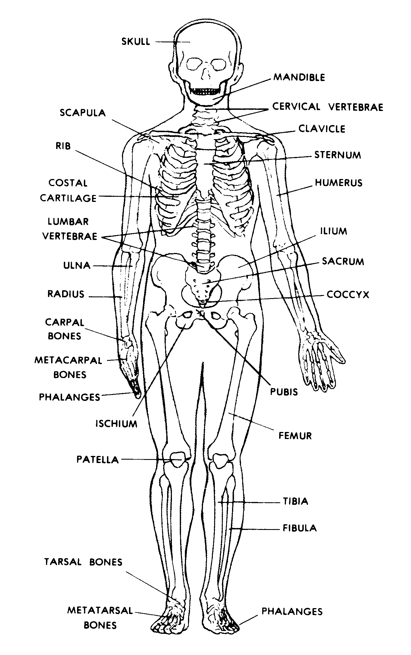
Challenge 1: Reference frame for the human body (2/2)
Identify nodes (e.g., start and end of branches), edges (e.g., vessels linking nodes), and locations on branches (e.g., using distance from end-nodes)
  Equivalent to use of street addresses by the US Post Office
Resolution important in automatically aligning certain structures in the body across snapshots
  Difficult if coordinate system’s resolution is too coarse
Generality across gender, age and other demographic variables
Reference frames for human body harder than those for Earth
http://www.medtrng.com/anatomy%20lesson/bph5.htm
Notes:
Pin-point vessel blockage and track changes over time

Slide 14
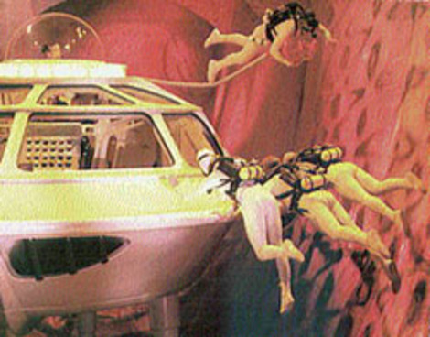
Challenge 2: Location Determination
Pinpoint specific locations/places in the body
  Remote telesurgical operation using surgical robots
Analogous to
  Using GPS to determine one’s location on the earth
Challenge lies in aligning each structure in the body across multiple 3-D images so that it can be guaranteed that the same structure is being observed.
Fantastic Voyage, IMDB, 1966, http://www.imdb.com/title/tt0060397/
Notes:
Taking snapshots of a street network so that traffic on a certain street can be monitored across different times

Slide 15
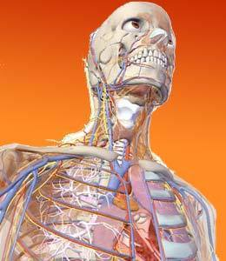
Challenge 3: Routing in a continuous space
Defining “routes” in the human body is an interesting challenge
  Deliver life-saving cancer-killing chemicals to brain tumors
Analogous structures to roads are blood vessels and anatomic divisions of organs
Example
  Find the shortest path to a brain tumor that minimizes tissue damage
    Unclear definitions of shortest path weight and paths in human body

Slide 16
Challenge 4: Defining change across snapshots
Change detection in tumors where images at different times need to be observed
  When will a tumor metastasize (spread)?
Images may be taken with different instruments across several visits
Calibration becomes a problem
  Changes in body chemistry can impact imaging and should be accounted for
    E.g., Fasting status pre-PET scan which alters physiologic distribution of radiotracer

Slide 17
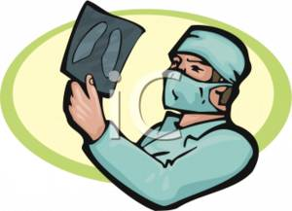
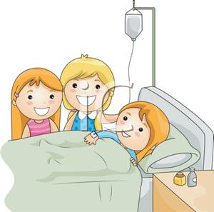
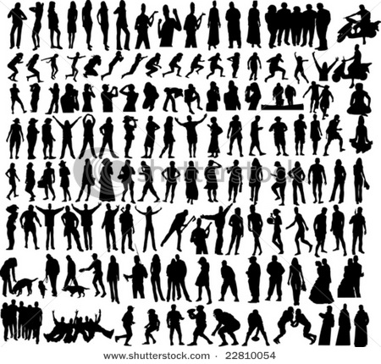
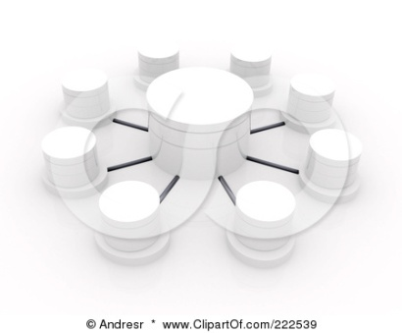


Challenge 5: Scalability
Need to scale up to Petabyte and Exabyte-sized data sets
  Large amounts of data produced from medical imaging techniques
  Replicating data across snapshots makes long term analysis prohibitive
Compression techniques not adequate for dynamic 3-D data with features like interactive zoom in and out across the time dimension
  Each snapshot of a large image might be approximately 8 - 16 gigabytes
    When this is multiplied by number of visits, number of images/visit and number of patients, scale increases to Exabytes

Slide 18
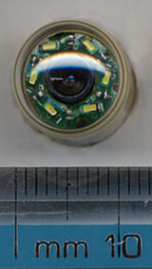
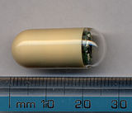
Challenge 6: Real-time mapping, change detection, routing
Real-time tracking of medical devices in peoples bloodstream, digestive tract, etc.
  E.g., tracking a device containing a tiny camera
Useful in emergency room settings
Dynamically detecting and reacting to changes
  Automatically increase/decrease medication based on patient’s reaction
Routing on the fly
  Change route based on new discovery such as rupture in blood vessels
Capsule endoscopy
http://en.wikipedia.org/wiki/Capsule_endoscopy

Slide 19
Summary
How can spatial and temporal databases help medicine?
Vision
  A spatial-temporal framework capable of answering long term questions
    Improve health care quality
    Provide doctors with a means of more quickly characterizing disease progression
Challenges
  Defining a reference frame for the human body
  Location determination
  Routing in a continuous space,
  Observing change across snapshots
  Scalability
  Real time mapping, change detection, routing
We encourage the Spatial Computing community to explore the vision and challenges we have proposed and we welcome future collaboration

Slide 20
Thank You!
Dev Oliver, oliver@cs.umn.edu
Daniel J. Steinberger, stein012@umn.edu
Questions?
Acknowledgement
SSTD Reviewers
This material is based upon work supported by the National Science Foundation under Grant No. 1029711, III-CXT IIS-0713214, IGERT DGE-0504195, CRI:IAD CNS-0708604, and USDOD under Grant No. HM1582-08-1-0017, HM1582-07-1-2035, and W9132V-09-C-0009
University of Minnesota Spatial Databases and Spatial Data Mining Research Group, www.spatial.cs.umn.edu
Professor Shashi Shekhar and Kim Koffolt

