Slide 1
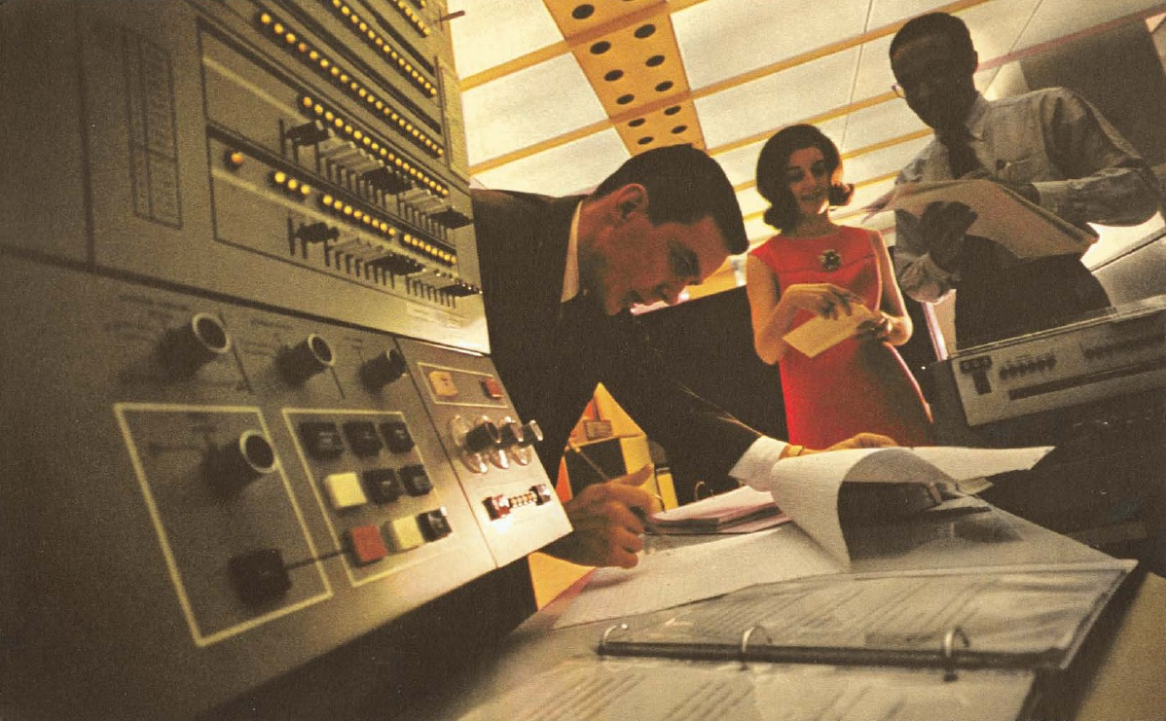
Underexplored Research Topics An Industry Perspective Erik Hoel esri
esri Super Secret Research Laboratory, August 2011

Slide 2
Agenda
History
Big Data
Imagery and Video
Lidar, Point Clouds, and 3D
Mobile Devices
Geostreaming
Dynamic GIS

Slide 3
Early History
Problems – Forrest Management, Land Management, Transportation Planning, Military, …
People – Garrison, Tobler, Tomlinson, Horwood, Fisher, etc.
Places – Univ. of Washington, US Forest Service, Biological Records Centre, Canada Land Inventory, Harvard Graphics Lab

Slide 4
1958
Univ. of Washington Department of Geography – center of intense advanced research on scientific quantitative geography (William Garrison and his students) – the ‘new geography’
Developed now classical techniques in spatial analysis, statistical methods, measure of spatial distributions, techniques of spatial comparison, 3D and n-dimensional analysis, network analysis, and geographic modeling techniques
Notes:
Many Universities were trying to shut down geography
This is where quantitative geography came into being

Slide 5
The New Geography
The change involved the greater use and emphasis placed on quantitative techniques
Experimental and statistical methodologies
Resulted in a new generation of geographers trained in contemporary methods of theory construction and data analysis
William Garrison’s Geography 426 class (Statistical Methods) in 1955 was a shock; students trained in statistical methods as well as an introduction to computers and their application (on an IBM 601)

Slide 6
The New Geography
Students of William Garrison:
Brian Berry – urban and regional research sparked geography’s social-scientific revolution - the most-cited geographer for more than 25 years; member NAS
William Bunge – theoretical geography (dependence of geographical theory on geometry and topological mathematics)
John Nystuen – fundamental spatial concepts (distance, orientation, connectivity)
Waldo Tobler – mathematics of projection, cartography
Other students: Duane Marble, Richard Morrill, Michael Dacey, John Kolars, Art Getis, Bob Mayfield, Ron Boyce

Slide 7
The New Geography
Other active UW faculty included Edward Ullman and Donald Hudson
As PhDs moved, many other faculty at other universities became involved in the movement; e.g.,
Richard Chorley, Peter Haggett, John Borchert, Leslie Curry, Leslie King, and Maurice Yeates

Slide 8
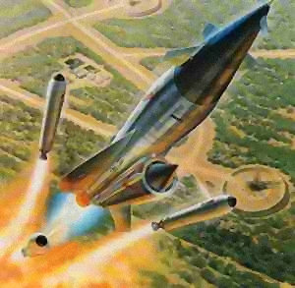
1958
TERCOM (Terrain Contour Matching) development starts at the USAF’s Wright-Patterson AFB
Missile guidance system
Basic premise is any geographic location on Earth is uniquely identified by the vertical contours of the surrounding terrain
Reference contour data stored in guidance system computer
First digital terrain model
First used with SLAM (Project Pluto) – nuclear ramjet powered supersonic low altitude cruise missile
SLAM

Slide 9
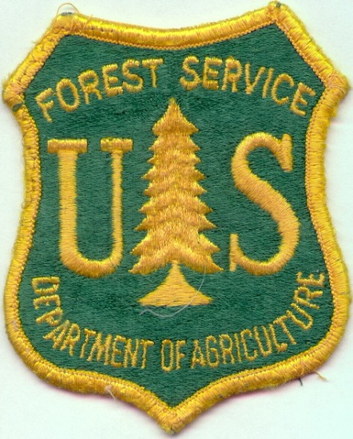
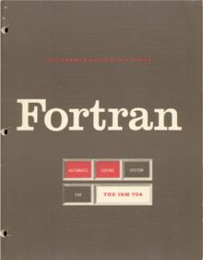
1960
Led by Robert Miller, the US Forest Service creates new forest inventory system using punch cards on the IBM 650 electronic tabulators
Considered major breakthrough in compiling data summaries – a true paradigm shift in processing field data
IBM 1620 moved USFS beyond tabulators; programmable in FORTRAN
Began hiring people to program (compile, edit, and analyze the data)
Notes:
Robert Miller was in some western field office, he came up with the idea of putting everything on punch cards and using the computer (tabulator) to count forest inventory information.
They liked his work so much that they bought him a more modern computer, the IBM 1620, allowing his work to go beyond tabulation.
The 1620 allowed programming (FORTRAN) and Hiring of programmers and analysts began
Forest inventory
Resource inventories
Note:vEarly-mid ’60’s was the period when a number of factors came together as a catalyst for GIS
Forest Inventory => Resource Inventory => Massive Data
Photogrammetry advancements
Computer + hardware advancements
http://www.geog.ubc.ca/courses/klink/gis.notes/ncgia/u23.html#SEC23.1
C. EARLY COMPUTER ERA
several factors caused a change in cartographic analysis:
computer technology - improvements in hardware, esp. graphics
development of theories of spatial processes in economic and social geography, anthropology, regional science
increasing social awareness, education levels and mobility, awareness of environmental problems
integrated transportation plans of 1950s and 60s in Detroit, Chicago
required integration of transportation information - routes, destinations, origins, time
produced maps of traffic flow and volume
University of Washington, Department of Geography, research on advanced statistical methods, rudimentary computer programming, computer cartography, most active 1958-611:
Nystuen - fundamental spatial concepts - distance, orientation, connectivity
Tobler - computer algorithms for map projections, computer cartography
Bunge - theoretical geography - geometric basis for geography - points, lines and areas
Berry's Geographical Matrix of places by characteristics (attributes) - regional studies by overlaying maps of different themes - systematic studies by detailed evaluation of a single layer

Slide 10
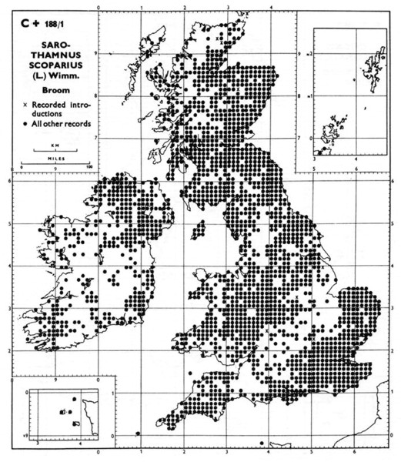
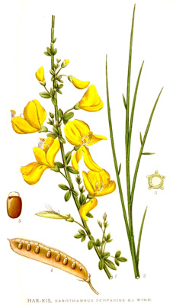
1962
Max Waters and Franklyn Perring (Biological Records Centre - BRC) author the Atlas of British Flora
BRC held the atlas data on record cards and punched cards
~1700 species
Used mechanical equipment for data-processing, using 40-column punched cards
One of the earliest machine readable geographical databases
Notes:
Each area is a ten by ten grid.
Divided England into these grid cells. Does a thing live there or not (one of first geographical databases)

Slide 11
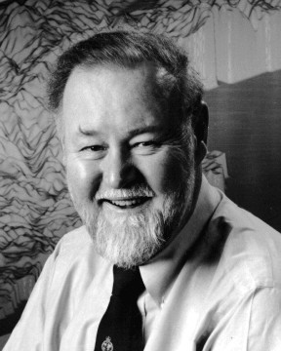
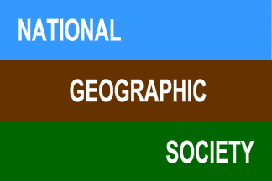
1963
“[Tomlinson is] generally recognized as the ‘father of GIS’.”
- URISA Hall of Fame
Development of CGIS (Canada Geographic Information System) starts, led by Roger Tomlinson
System was needed to analyze Canada's national land inventory and pioneered many aspects of GIS
A very significant milestone
First widespread use of “geographic information system” terminology (1966)
Over 40 people actively involved in developing CGIS between 1960-1969
Built by IBM under contract to the Canada Land Inventory
Tomlinson
Roger became a charter
member in 2005 of the
URISA Hall of Fame
Roger won the 1995
Anderson Medal of Honor
Association of American Geographers
Roger won the
Alexander Graham Bell Medal
Extraordinary Achievement in Geographic Research
Notes:
The year 1964 saw the development of the world's first true operational GIS in Ottawa, Ontario by the federal Department of Energy, Mines, and Resources.
Far too much information to handle manually
1965 – Estimated to cost $8million Canadian and requirement for 556 technicians for three years in order to overlay the1:50,000 scale maps of the Canada Land Inventory: this unacceptable level of resources acted as an incentive to develop a more automated approach.
Born in Cambridge, England, Dr. Tomlinson adopted Canada as his home in 1957. During the spring of 1962, while on a plane bound from Ottawa to Toronto he met Lee Pratt, then recently named head of the Canada Land Inventory (CLI). Tomlinson then was chief of the computer mapping division at a Canadian airline service. Pratt described a vast mapping project CLI was about to undertake - a multilayer land-use/ planning map of Canada's inhabited and productive land--around 1 million square miles. Tomlinson told Pratt some of his ideas might work for CLI and Pratt eventually hired him to head the program that resulted in the first GIS.
The real push towards computerization of spatial data came with
Forest inventory which later became Resources inventory
Far too much information to handle manually
Roger Tomlinson and East Africa project in 1960 – worked for an air survey company (Spartan Air Services) which was undertaking a forest survey in East Africa: Analyze all available map sources to identify locations for new plantations for a new mill. Estimated costs of doing this manually were so high that the proposal was rejected:
1965 – Estimated to cost $8million Canadian and requirement for 556 technicians for three years in order to overlay the1:50,000 scale maps of the Canada Land Inventory: this unacceptable level of resources acted as an incentive to develop a more automated approach.
Tomlinson argued that such analyses could be undertaken by computers and was given the opportunity to develop a digital methodology. IBM expressed interest in this idea; IBM was already involved in digitizing air photographs. Tomlinson met Department of Ag administrator, planning a Canada Land Inventory (CLI) involving the production of many maps of land capability for the whole of settled Canada. Tomlinson expressed his belief that computer-based techniques would perform such analyses both faster and more cheaply. Spartan Air was awarded a contract to undertake a feasibility study of a computer mapping system for the CLI. Report was accepted by Dept of Ag., and he was invited to direct its development. Led to several significant developments for the future of GIS:
Creation of a drum scanner for the rapid digitization of maps (based on earlier IBM work on digitizing aerial photographs)
Data indexing scheme (the Morton Index 1966
Topological coding of boundaries involving the first known use of the link/node concept of encoding lines.
The drum scanner, together with digitizing tables, provided the input to the system which was then based on an IBM 360/65 mainframe; output could be by line printer for numerical results and by ponderous Gerber plotter for graphical output.
Jack went to Harvard in 1968 (Masters in
Tomlinson left the CGIS project in 1969
The result was that in 1966 he was able to persuade the Canadian Government that the creation of the Canada Geographic Information System (CGIS) in 1966 was a worthwhile investment.

Slide 12
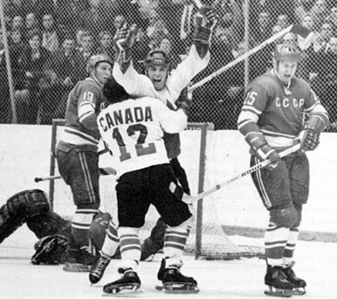
CGIS
Advances pioneered by CGIS
First cartographic scanner (48”)
Raster to topological vector conversion (Don Lever)
Integration of scanning, digitizing, and keypunch data encoding
Morton coding (indexing) and compression (Guy Morton)
Topological coding of boundaries (first known use of the link/node concept); attaching polygon attributes to points (spaghetti and meatballs)
Automated edge matching across tiles/sheets
Spatial coordinate systems
Command language for data overlay
Paul Henderson
Notes:
1972 Canada beat Russia in Moscow : Nations Cup
CGIS was the world's first "system" and was an improvement over "mapping" applications as:
it provided capabilities for overlay, measurement, and digitizing/scanning.
It supported a national coordinate system that spanned the continent,
coded lines as "arcs" having a true embedded topology,
and it stored the attribute and locational information in separate files.
his use of overlays in promoting the spatial analysis of convergent geographic data
-----
http://www.geog.ubc.ca/courses/klink/gis.notes/ncgia/u23.html#SEC23.1
D. CANADA GEOGRAPHIC INFORMATION SYSTEM (CGIS)
Canada Geographic Information System is an example of one of the earliest GISs developed, started in the mid '60's
is a large scale system still operating today
its development provided many conceptual and technical contributions
Purpose
to analyze the data collected by the Canada Land Inventory (CLI) and to produce statistics to be used in developing land management plans for large areas of rural Canada
the CLI created maps which:
classify land using various themes: soil capability for agriculture recreation capability capability for wildlife (ungulates) capability for wildlife (waterfowl) forestry capability present land use shoreline
were developed at map scales of 1:50,000
use a simple rating scheme, 1 (best) to 7 (poorest), with detailed qualification codes, e.g. on soils map ____________________ 1see pages 62-66 in Johnston, R.J., 1983. Geography and Geographers: Anglo-American Human Geography since 1945, 2nd edition, Edward Arnold (Publishers), London.
may indicate bedrock, shallow soil, alkaline conditions
product of CLI was 7 primary map layers, each showing area objects with homogeneous attributes
other map layers were developed subsequently, e.g. census reporting zones
perception was that computers could perform analyses once the data had been input
Technological innovations
CGIS required the development of new technology
no previous experience in how to structure data internally
no precedent for GIS operations of overlay, area measurement
experimental scanner had to be built for map input
very high costs of technical development
cost-benefit studies done to justify the project were initially convincing
major cost over-runs
analysis behind schedule
by 1970 project was in trouble
failure to deliver promised tabulations, capabilities
completion of database, product generation under way by mid 1970s
main product was statistical summaries of the area with various combinations of themes
later enhancement allowed output of simple maps
CGIS still highly regarded in late 1970s, early 1980s as center of technological excellence despite aging of database
attempts were made to adapt the system to new data
new functionality added, especially networking capability and remote access
however, this was too late to compete with the new vendor products of 1980s
Key innovative ideas in CGIS
overhead - Key ideas in CGIS
use of scanning for input of high density area objects
maps had to be redrafted (scribed) for scanning
note: scribing is as labor intensive as digitizing
vectorization of scanned images
geographical partitioning of data into "map sheets" or "tiles" but with edgematching across tile boundaries
partitioning of data into themes or layers
use of absolute system of coordinates for entire country with precision adjustable to resolution of data
number of digits of precision can be set by the system manager and changed from layer to layer
internal representation of line objects as chains of incremental moves in 8 compass directions rather than straight lines between points (Freeman chain code)
coding of area object boundaries by arc, with pointers to left and right area objects
first "topological" system with planar enforcement in each layer, relationships between arcs and areas coded in the database
separation of data into attribute and locational files
"descriptor dataset" (DDS) and "image dataset" (IDS)
concept of an attribute table
implementation of functions for polygon overlay, measurement of area, user-defined circles and polygons for query

Slide 13
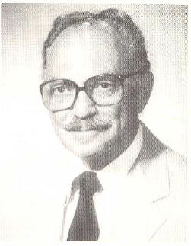
1963
Edgar Horwood (Washington) conducts training workshop at Northwestern on his Card Mapping Program and Tape Mapping Program
Programs displayed thematic data associated with statistical administrative zones
Inspired Howard Fisher to create SYMAP
Horwood led the creation of URISA and served as first president
Prior to 1960, offered first academic course utilizing computer processing of geographic information (according to Nick Chrisman)
Don became a charter
member in 2005 of the
URISA Hall of Fame
Notes:
Edgar Horwood applied computers to urban planning; began in 1960
Wrote programs to create maps
Provided training workshops for his programs
he used the first computers at the University of Washington to map land use activity around interstate intersections.
Fisher at NW then?
-----
This was a Bureau of Public Roads grant to study pressures on zoning at six freeway intersections across the nation. This was followed in 1961 with a Community Renewal Plan (CRP) project in the City of Spokane, and a NSF-sponsored software development project at the University of Washington. The CRP created a need for analysis and mapping of 1960 Census of Population and Housing data, and the creation of a parcel-level database. The software development process responded to these needs. A suite of four programs was programmed in Fortran for the IBM 709 computer. The first two programs were designed for small data sets of 10 to 100 areal units for mapping data at the census tract level. The second two programs were designed for large data sets of 1000 to 10,000 areal units, represented as points for mapping data at the census block level.
The first two programs were called the ARRAY and the CARD MAPPING. The ARRAY program rank ordered values for a census tract variable and drew for each tract a bar proportional to the value of the variable. These arrays were used to identify natural breaks in the data that were used to establish ranges for mapping of census tract data using the CARD MAPPING program. The CARD MAPPING program produced a choropleth map using standard printers. Users specified parameters to select variables from the punch cards and performed calculations to produce arrays and maps.
The second two programs were called the DISTRIBUTION and the TAPE MAPPING. The DISTRIBUTION program served to aid in the identification of mapping ranges for a larger number of observations. The TAPE MAPPING program produced symbol maps to represent the value ranges for census block data.
Horwood was an early requester of digital data from the Bureau of the Census, which led to heavy involvement of Census in URISA and in the development of the their data user access program. But in 1961 the census block data were not yet published, nor did Horwood want to keypunch the data again. So he requested from the U. S. Bureau of the Census the Spokane block data. What he received was data on a magnetic tape in a UNIVAC code that was unreadable on the IBM 709. Consequently, he was forced to invest heavily in time and resources to convert the data for use by the DISTRIBUTION and TAPE MAPPING programs.
Clark Rogers, Arnold Rom, and Bill Clark were key players in the development of the software, data, urban planning application, and supporting educational program. Arnold Rom wrote the four programs, Clark Rogers took the lead on the application and education components, and Bill Clark decoded the tapes from the Bureau of the Census. Clark Rogers and Bill Clark were also principal instructors with Horwood in the offering of a short course in Los Angeles in 1962, several offerings in 1963, Pittsburgh, Berkeley, Evanston, New Haven, and the first conference in Los Angeles. Clark Rogers left for the University of Pittsburgh in 1963 and Ken Dueker joined Horwood’s staff. In 1964, Horwood conducted a month-long summer institute version of the short course that was sponsored by the National Science Foundation. Also in 1964, Clark Rogers organized the next conference on Urban Planning Information Systems and Programs in Pittsburgh. In 1964, Dueker moved to Northwestern University where he and Bill Garrison organized the 1965 conference. Horwood and Dueker also conducted the last of the short courses at the University of Michigan in 1965.
During this period there was a shift in emphasis from software development with a supporting educational program aimed at the planning community, to the provision of analytical services. First, it was recognized that the short courses were insufficient to get people up and running, and several requested follow-up assistance. Performing this function proved difficult within the University and Horwood, Bill Clark, Ken Dueker, Charles Graves, and Hugh Calkins formed a firm called Applied Computer Research Corporation to service out-of-state clients. This thrust precluded further development of the four programs and their porting to new platforms, such as the IBM 360. Others did not pick up and develop the software because Horwood and Bill Clark did not want to lose control by release of the source code. Consequently, the initial software development and training program thrust lost momentum and Horwood moved in the direction of new software developments, such as the Street Address Conversion System led by Bob Dial, and its application at the National Capitol Commission in Ottawa and the Dominion Bureau of Statistics (now Statistics Canada).
While Horwood shifted attention from improving mapping software to address computer applications to support planning and administration, and institutional issues of adapting to new technologies, Howard Fisher, who attended the 1963 short course in Evanston assumed the challenge to develop a better card mapping program. In 1964 Fisher released the first version of SYMAP that extended choropleth mapping to contour mapping and used overprint characters to produce solid map symbols. In 1965 he moved from Northwestern University to Harvard where he established the Harvard Computer Graphics Laboratory. Fisher released the source code and emphasized software R&D. ArcInfo descends from the Harvard R&D program.

Slide 14
Horwood’s Short Laws
Good data is the data you already have
Bad data drives out good
The data you have for the present crisis was collected to relate to the previous one
The respectability of existing data grows with elapsed time and distance from the data source to the investigator
Data can be moved from one office to another but it cannot be created or destroyed

Slide 15
Horwood’s Short Laws
If you have the right data you have the wrong problem and vice versa
The important thing is not what you do but how you measure it
In complex systems there is no relationship between information gathered and the decision made
Acquisition from knowledge is an exception
Knowledge flows at half the rate at which academic courses proliferate
Notes:
Black swans

Slide 16
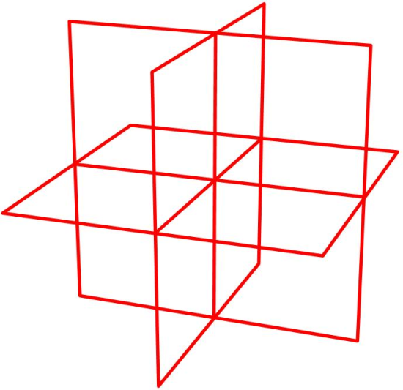
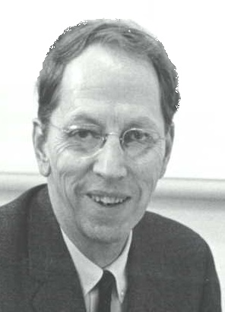
1964
The Harvard Lab for Computer Graphics and Spatial Analysis was established by Howard Fisher
Large grant from the Ford Foundation
Very significant research center, created pioneering software for spatial data handling
Many key individuals in industry participated:
Jack Dangermond, Scott Morehouse, Hugh Keegan, Duane Niemeyer, and Lawrie Jordon (Esri)
David Sinton (Intergraph), Lawrie Jordon and Bruce Rado (ERDAS)
Fisher
“[The Lab] was an important early moment in the development of what has evolved in GIS over the past four decades. The contributions of the lab included the training of many creative students and researchers who left the lab to make greater advances elsewhere.”
- URISA Hall of Fame
The Lab became a charter
member in 2005 of the
URISA Hall of Fame
Notes:
The Harvard Lab for Computer Graphics was an important early moment in the development of what has evolved in GIS over the past four decades.
Included the training of many creative students and researchers who left the lab to make greater advances elsewhere.
http://www.urisa.org/node/398
The Harvard Lab for Computer Graphics was an important early moment in the development of what has evolved in GIS over the past four decades. The contributions of the lab included the training of many creative students and researchers who left the lab to make greater advances elsewhere. The Harvard Lab for Computer Graphics (reorganized as the Harvard Lab for Computer Graphics and Spatial Analysis in 1968) was one of several sites in the early development of GIS where seminal innovations in the processing and display of geographically referenced data took place. Many of the present generation of GIS professionals first experienced computer cartography through the widely distributed automated mapping application SYMAP, completed at the lab in 1966. SYMAP was widely generalizable and drew from mathematical cartography in producing isoline, choropleth, and proximal maps using a standard line printer as an output device. Since Harvard had no departmental geography at the time, the initial focus of the lab was directed toward the needs of landscape architects, urban and regional planners, and resource managers and early GIS applications revolved around those disciplines.
http://www.geog.ubc.ca/courses/klink/gis.notes/ncgia/u23.html#SEC23.5
E. HARVARD LABORATORY
full name - Harvard Laboratory For Computer Graphics And Spatial Analysis
Howard Fisher, moved from Chicago to establish a lab at Harvard, initially to develop general-purpose mapping software - mid 1960s
Harvard Lab for Computer Graphics and Spatial Analysis had major influence on the development of GIS until early 1980s, still continues at smaller scale
Harvard software was widely distributed and helped to build the application base for GIS
many pioneers of newer GIS "grew up" at the Harvard lab

Slide 17
Harvard Lab
Many key academics also participated:
Nick Chrisman
Geoff Dutton
Randolf Franklin
Tom Poiker
Carl Steinitz
William Warntz
Notes:
Franklin, Dutton, Chrisman are still active in the GIS community.
Chrisman reviewed this presentation.

Slide 18
Harvard Packages
SYMAP – general purpose mapping, output on line printer, simple to use, enormous interest
CALFORM – SYMAP on a pen plotter, table of point locations
SYMVU – 3D perspective views of SYMAP output, first new form of spatial display
GRID – raster cells, multiple layers
POLYVRT – topology, format conversion
ODYSSEY – comprehensive vector analysis, first robust and efficient polygon overlay (including sliver removal)
Notes:
Many of the present generation of GIS professionals first experienced computer cartography through the widely distributed automated mapping application SYMAP, completed at the lab in 1966. SYMAP drew from mathematical cartography in producing isoline, choropleth, and proximal maps using a standard line printer as an output device.
SYMAP became, in its time, the world's most widely used computer mapping program.
Polyvrt - One of the first topology models.
Scott worked on Odyssey, last hurrah from Harvard Lab
----
Carl Steinitz:
http://www.gsd.harvard.edu/studios/brc/framework/steinitz.txt
Between 1966 and 1968 the Laboratory developed rapidly as a service organization to Harvard and to many "outside" projects which were used to test or demonstrate the new GIS and computer-mapping capabilities. An important policy of the Laboratory was to disseminate its programs for the widest possible use. Correspondence training in the use of SYMAP and other programs was offered, and several intensive instructional sessions were held at various universities and other organizations. The Laboratory held annual conferences (the first at Harvard in the Spring of 1967) and weekly luncheon seminars dealing with many aspects of the Laboratory's research interests for example, pattern recognition strategies. The Laboratory also produced many publications, most notably the Harvard Papers in Theoretical Geography. Many computer programs were developed, tested, and widely distributed. Among them were: SYMAP, a general purpose line printer mapping program; CALFORM, a conformal mapping program for use with a pen plotter; SYMVU, a pen plotter surface-perspective mapping program; POLYVRT, a cartographic data base manipulation program; and the beginnings of the ideas that led to ODYSSEY, a geographic data management, analysis, and display system. Some of these programs have a traceable genealogy. For example, it was clear from the onset that there were inefficiencies in the way SYMAP operated and that it was extremely difficult for people to use. The teaching of this program and its use required people to learn a computer language, FORTRAN. Many of its GIS concepts were reorganized several times. The first, GRID, was a data management program which could more efficiently structure raster-based cartographic analyses for SYMAP. It became obvious to David Sinton (then a graduate student) that SYMAP's repetitive operations approach could be much more simply organized in a keyword structure. David then conceived and developed IMGRID which we used in a wide variety of applications during the early 1970s. In the mid-1970s and while a student, Dana Tomlin saw ways in which the keyword approach of IMGRID could be changed to an English-using command language. He conducted a series of experiments which became a basis of his doctoral thesis at Yale and ultimately resulted in the Map Analysis package (MAP). Dana joined our faculty, and another group of students was prepared. These included David Hulse, who wrote MACGIS. Today, Stephen Ervin and our students continue to develop GIS applications. We are now part of a world- wide network of colleagues; we hope that our contribution to GIS will continue.

Slide 19
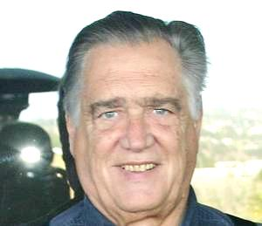
1970
First Law of Geography by Waldo Tobler
Everything is related to everything else, but near things are more related than distant things
First GIS conference sponsored by the International Geographical Union (IGU)
Representatives of all known GIS systems invited
40 participants
Tobler
Notes:
The first law of geography according to Waldo Tobler is "Everything is related to everything else, but near things are more related than distant things.“
This observation is embedded in the gravity model of trip distribution. It is also related to the law of demand, in that
interactions between places are inversely proportional to the cost of travel between them,
which is much like the probability of purchasing a good is inversely proportional to the cost.
Defense Advanced Research Projects Agency
Packet switching, now the dominant basis for both data and voice communication worldwide, was a new and important concept in data communications.
Packet switching is a communications paradigm in which packets (units of information carriage) are routed between nodes over data links shared with other traffic. This contrasts with the other principal paradigm, circuit switching, which sets up a dedicated connection between the two nodes for their exclusive use for the duration of the communication. Packet switching is used to optimize the use of the channel capacity available in a network, to minimize the transmission latency (i.e. the time it takes for data to pass across the network), and to increase robustness of communication.

Slide 20
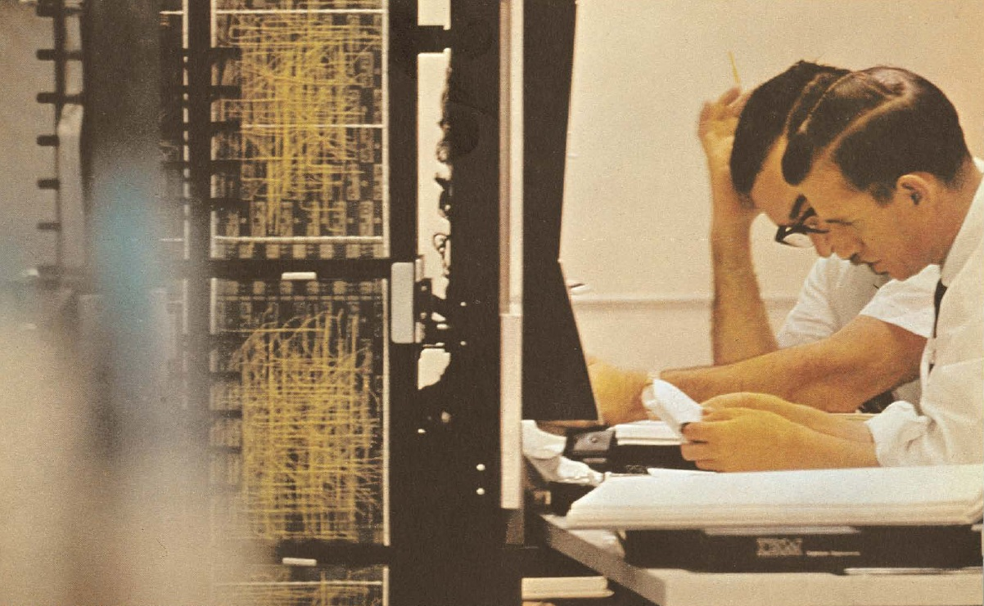
Big Data

Slide 21
Big Data
Basically, extremely scalable analytics
The three Vs
Volume – petabytes and more
Velocity – real time acquisition and analysis
Variety – structured, unstructured, and semi-structured
Notes:
James Kobielus – Forrester Research

Slide 22
Big Data
Example data
Full motion video
Multi/hyper-spectral imagery
Cell phone calls
Register transactions
Lidar/point clouds
Email/tweets
Space/time critical

Slide 23
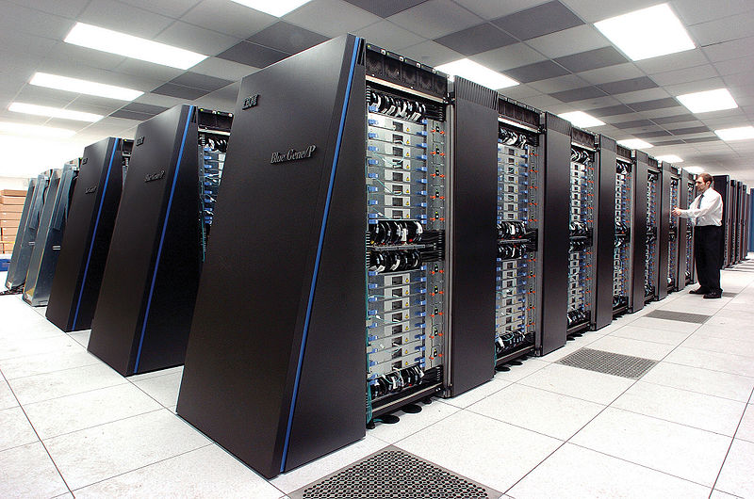
Big Data
Query Optimization
Traditional data types solved long ago
Big problems with extended data types
Revert to full table scans
One solution: massively parallel systems, data partitioning, etc.
IBM’s Netezza, Oracle’s Exadata, Microsoft’s SQL Azure, Apache’s Hadoop, Teradata, among others
Can a finely tuned query win?
IBM’s
Blue Gene

Slide 24
Big Data
How to stream for real time event processing
Store to disk/post process
Analyst with manual inspection
Slow
How to persist/partition and rapidly search

Slide 25
Big Data
Search criterion controlling storage
Based upon predicate filtering
Temporal, then spatial, or vice versa
Placenames
Type of attribute/tags
Sensor platform attributes
Column-oriented stores

Slide 26
Big Data
Peeking at data as it flows in
Identify interesting bits, ignore most
When is something near, when does something cross …
Query optimization problem
Existing frameworks
Microsoft, Oracle, IBM, etc.

Slide 27
Move is to dynamic data, applying analytics to large volumes, reporting facts as available
Data Streams
Discovery
Filter/Store/Analyze
Disseminate
Analytics, filters, correlation results
Alerts, facts, etc. feed into other Analysts
Analyst
CLOUD BASE
Analytics run in
GRID Computing,
Hadoop, and
Map Reduce
environment
Question focused datasets
Creates the analytics to apply to the data stream based on
Pattern Analysis
Reports, analysis, other web pages

Slide 28
Big Data
Detecting patterns, connecting thing together
Social media type stuff with spatial/temporal
Cash register transactions, cell phone calls
Pattern of life
“Connecting the dots spatially”
Knowns and unknowns
How to assign unknowns to knows
How to assign confidences

Slide 29
Temporal Anomalies
A half-million Enron e-mails from ~150 accounts were sent from 1999 to 2001, a period when Enron executives were manipulating financial data, making false public statements, engaging in insider trading, and the company was coming under scrutiny by regulators
The graph reveals a map of a week's e-mail patterns in May 2001, when a new name suddenly appeared
This week's pattern differed greatly from others, suggesting different conversations were taking place that might interest investigators

Slide 30
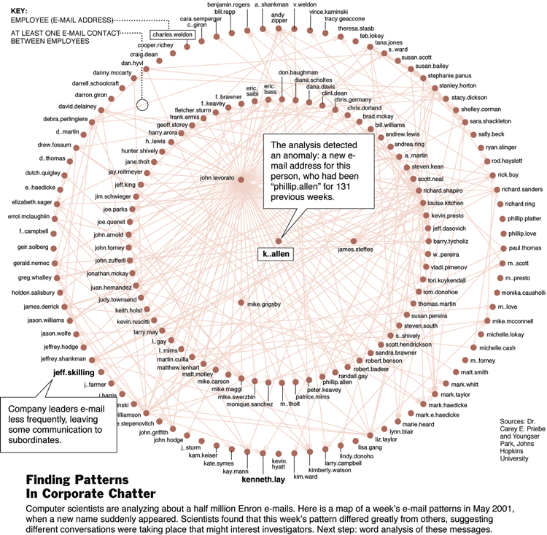
Temporal Anomalies

Slide 31
Big Data
Spatio-temporal web crawlers
Trends and spatial activity
Social media
Meaningful persistence
Fast, geolocate, query

Slide 32
Non-traditional Data
Lots of non-spatial data
CSV/TXT files, Excel spreadsheets, news feeds, social media
Coarse grained spatial data
City level, not down to 10 meters …
E.g., Fukushima radiation
Geoprocessing and trend analysis/detection

Slide 33
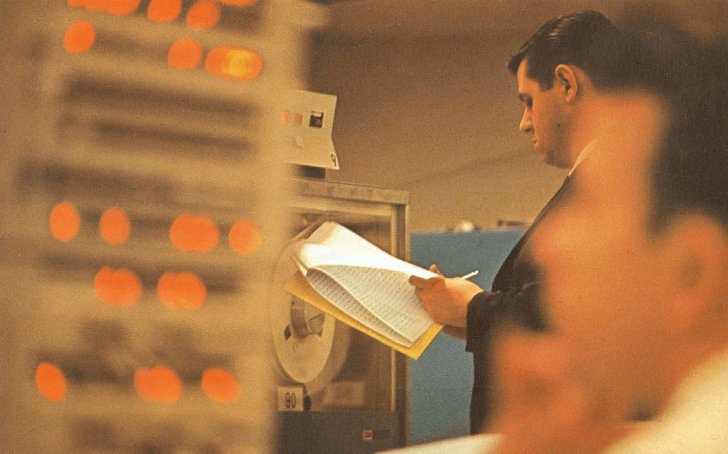
Imagery and Video

Slide 34
Imagery
Data management problems solved
Reliable feature extraction
Very high value/demand area
Data fusion
Full motion video

Slide 35
Reliable Feature Extraction
Need ability to combine image sources with algorithms
E.g., GeoEye-1 + easy to use tools -> rooftops
Users willing to tie capabilities to sources
With EROS B, here are 4 things you can do
With SPOT5, here are 5 things you can do …
Currently, image processing systems need PhD level analysts to run semi-automated systems
Solutions attempt to be too general

Slide 36
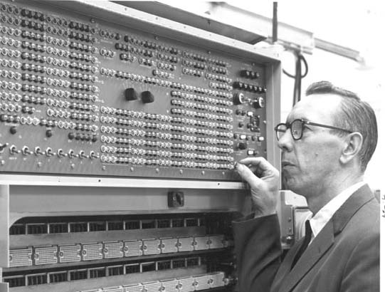
Not so good user experience

Slide 37
Reliable Feature Extraction
Feature extraction is a huge deal even if tied to a specific commercial data source
Key is not to be too generic
3D feature extraction
Trees from point clouds
Signage from car imagery

Slide 38
Object Recognition
Identification of objects at a coarse level
Simpler than feature extraction (a car vs. Fred’s car)
Analyze shape with simple transformation
Examples:
Where are the planes at the airport (not which planes are at the airport)?
Where are the parking spaces in a city, how many are there?
Image understanding
Not edge detection, …
<image>

Slide 39
Object Recognition
Identification of objects at a coarse level
Simpler than feature extraction (a car vs. Fred’s car)
Analyze shape with simple transformation
Examples:
Where are the planes at the airport (not which planes are at the airport)?
Where are the parking spaces in a city, how many are there?
Image understanding
Not edge detection, …
<image>

Slide 40
Object Recognition
Identification of objects at a coarse level
Simpler than feature extraction (a car vs. Fred’s car)
Analyze shape with simple transformation
Examples:
Where are the planes at the airport (not which planes are at the airport)?
Where are the parking spaces in a city, how many are there?
Image understanding
Not edge detection, …
<image>
Family eating a weekend breakfast in the late 1950s/early 1960s

Slide 41
Full Motion Video
Way too much data to store/archive
Need to isolate interesting time slices in video streams
E.g., detect the moving objects, store them
Want to identify moving objects and tag them
Over time, if a previously identified object reappears in the video stream, highlight it, store it, etc.
UASs, security cameras, environmental management (gorillas in the jungle), etc.

Slide 42
Full Motion Video
Integrating full motion video into 3D maps
Geopositioned (and oriented) video insets
E.g., video of truck moving down a dirt road being projected appropriately onto interactive map display

Slide 43
Compression
Lots of good general purpose compression
Wireless carriers doing a lot of work (3G vs. 4G)
Need data specific compression techniques
Compression tied to data or type of request
Optimize the transport; huge issue with wireless
E.g., User A wants 10m accuracy data, User B wants 50m accuracy data
Need table compression, not row by row compression

Slide 44
Data Fusion
Combining different sensors on different platforms and fuse into derived product that is useful
Examples:
Lidar + multispectral imagery = RGB Lidar (simplistic classification – green implies tree)
AIS + satellite SAR = ships causing surface pollution on the ocean

Slide 45
Data Fusion
Future example: imagery + range detection = mensuration
How tall is a building?
Platform – combination of hardware and software that is placed on satellite, UAS, or aircraft
Platform to find IEDs – hyperspectral imagery and SAR
Platform to find rooftops – which sensors and software?

Slide 46
Imagery
Imagery is more than a pretty background in GIS
Hard to convince people it is useful

Slide 47
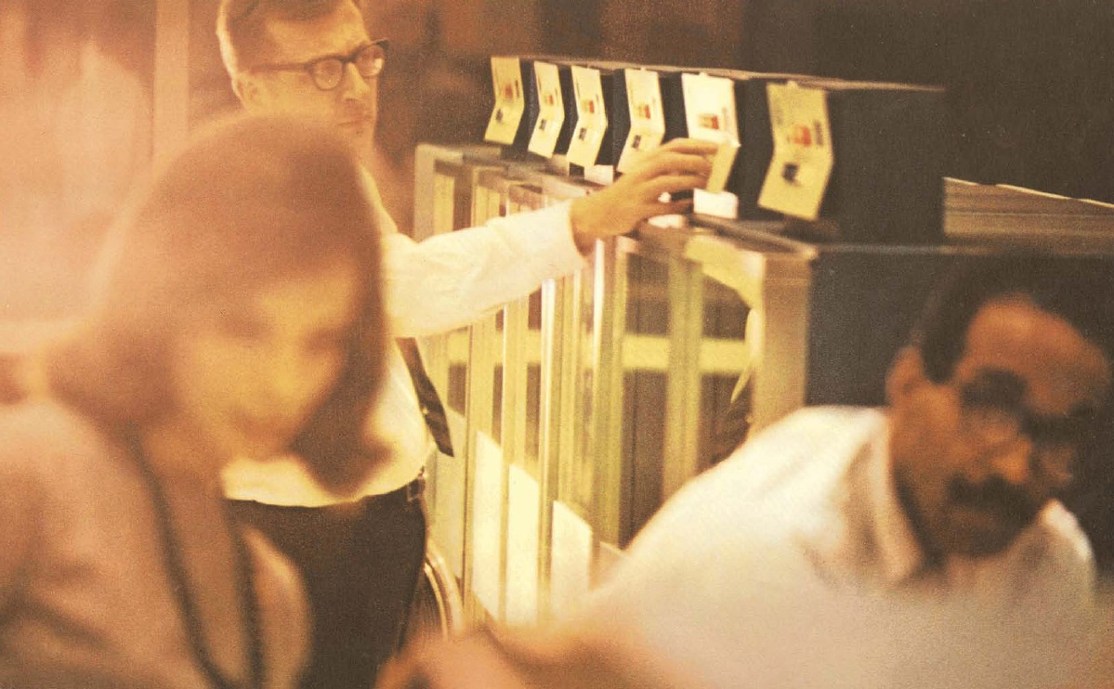
Topology Editing
Lidar, Point Clouds
and 3D

Slide 48
Lidar
There is lots of Lidar out there, what can be done in specific problem domains?
E.g, vegetation growth near powerlines
Lidar needs to move beyond basic classification, visualization, surface generation, and change detection; e.g.,
Immersive point clouds
Inside buildings
<Petrovic video>

Slide 49
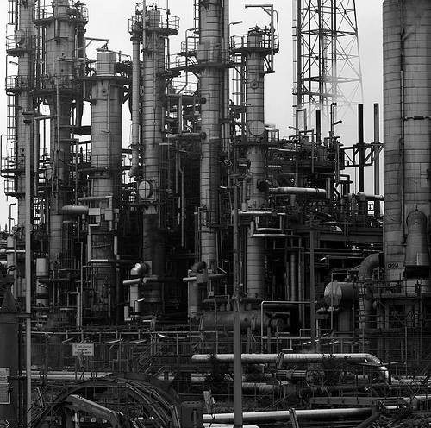
Point Clouds
Use as reference; interesting opportunities for automated (or semi-automated) feature extraction
Complex examples: oil refineries, manufacturing plants

Slide 50
3D
Still large disconnect between 2D and 3D
Collected and stored differently
E.g., store a tree as a point with attributes and rules, applied at runtime for visualization or analysis
AutoCAD
Analytical 3D still in infancy
Mining industry is where big interest is
Visual analytics
Seeing trends/relationships
Notes:
Black swans

Slide 51
3D
The ability to manage 3D features is problematic
Editing workflows and input devices are still awkward to use
Look to Hollywood?

Slide 52
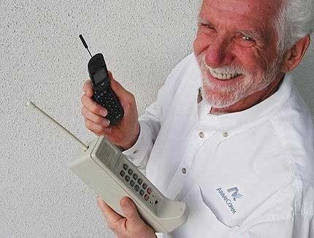
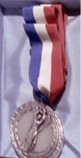
1973
First call on a mobile cell phone made by its inventor Martin Cooper at Motorola
Call placed to his rival Joel Engell, Bell Labs' head of research
Resulted in a fundamental technology and communications market shift toward the person and away from the place
Cooper stated that his research was inspired by watching Capt. James T. Kirk using his communicator on Star Trek
Cooper
James will receive the 2267 Starfleet Medal of Honor
Kirk
Notes:
http://en.wikipedia.org/wiki/Martin_Cooper_(inventor)

Slide 53
Modeling Hierarchies
Modeling building interiors and cities very difficult
Hierarchies (table, room, apartment, floor, building, block, city, …) without redundancy
3D, networks, infrastructure, underground
How to merge/abstract
<Sydney video>

Slide 54
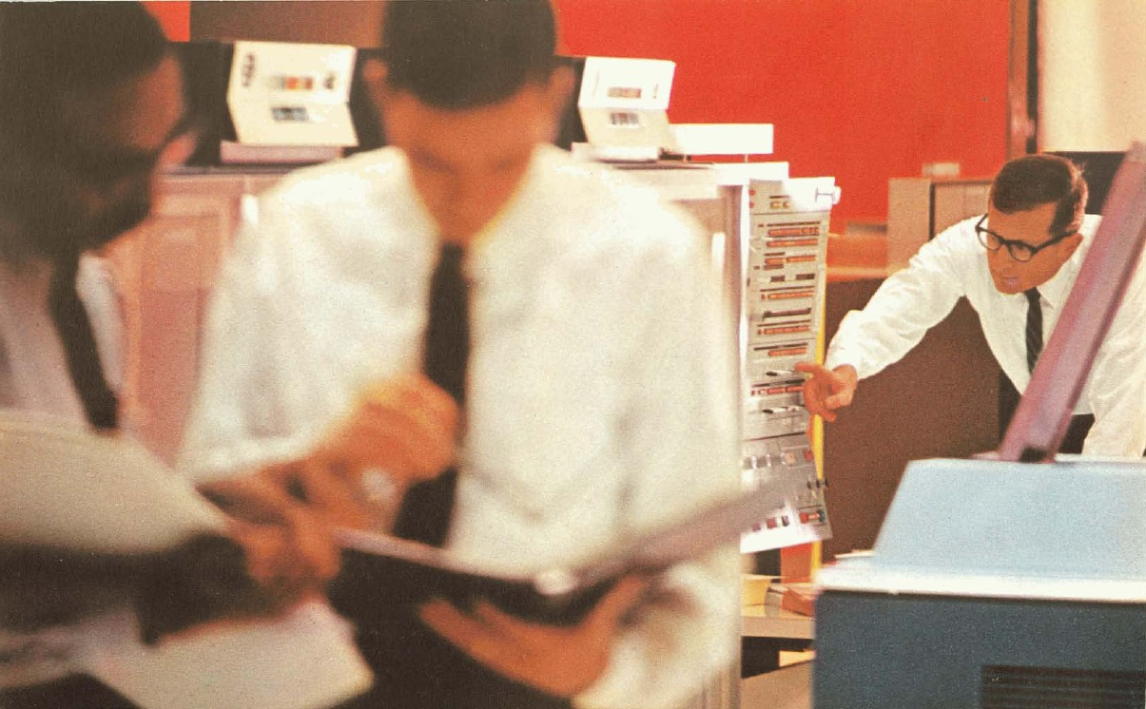
Versioning
Mobile Devices

Slide 55
Mobile Devices
Developing for mobile “feels like Windows 95”
Primitive by today’s standards
Data storage remains the biggest challenge
RDBMS-based storage problematic
Still using traditional techniques – e.g., R-tree in conjunction with SQLite
>>95% of time is spent drawing
RDBMS not optimized for this

Slide 56
Mobile Devices
Need good spatial clustering and column-based structuring
Need to move beyond RDBMS and SQL
Expressing search still hard – time, space, attributes, network connectivity, etc.

Slide 57
Mobile Devices
How do these fit into the remote sensing community?
Lots of info with all the photos
Consider micro-platforms on mobile devices
Everyone is a walking sensor
Imagery, accelerometers, inclinometers
Does it make sense to build platforms on mobile devices?

Slide 58
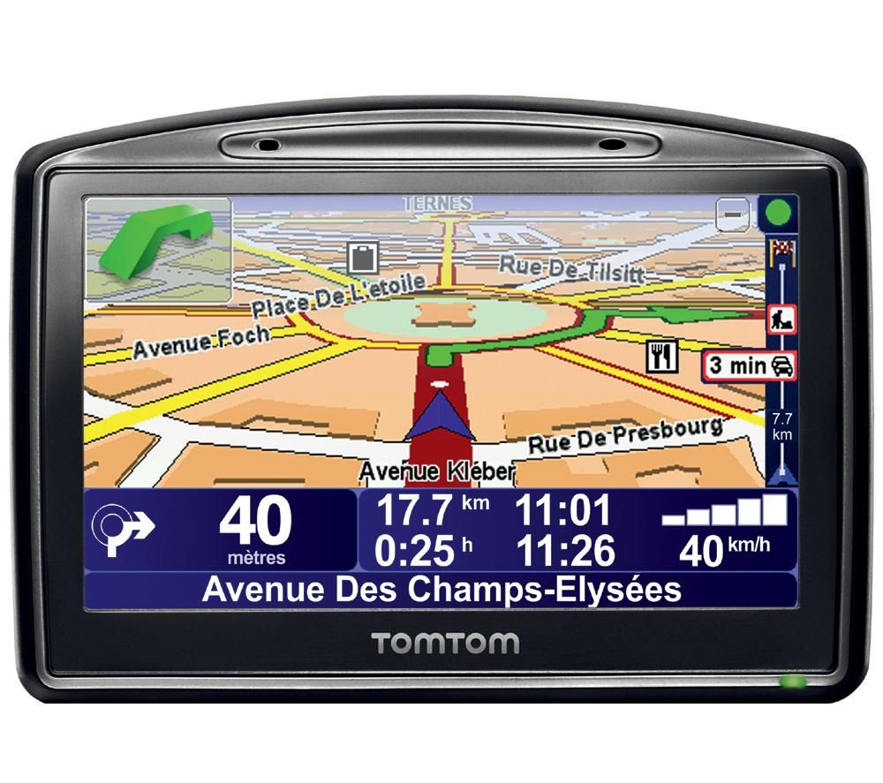
Mobile Devices
With mobile, users are standing in the map
Differs from desktop
Are there more effective ways of communicating situational awareness in the field?
E.g., driving directions and tilting the display
Augmented reality
Audio

Slide 59
Mobile Devices
Current examples
Earthquake detection
Pothole detection
Future examples
GM’s OnStar-like. system – your phone detects travel on road and sudden violent deceleration; auto-calls for help
You have a skin rash – take a multispectral image of it and upload to a doctor service. What kind of rash is it? Do I need to be seen by the doctor? Is over the counter OK?
Don Cooke’s cat

Slide 60
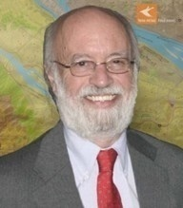
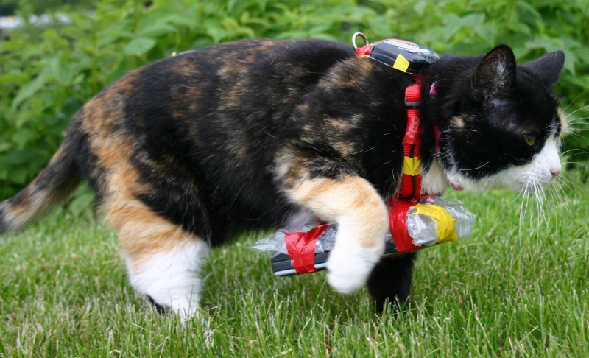
Mobile Devices
Current examples
Earthquake detection
Pothole detection
Future examples
GM’s OnStar system – your phone detects travel on road and sudden violent deceleration; auto-calls for help
You have a skin rash – take a multispectral image of it and upload to a doctor service. What kind of rash is it? Do I need to be seen by the doctor? What do I do?
Don Cooke’s cat
Don Cooke
Mary the GPS Cat

Slide 61
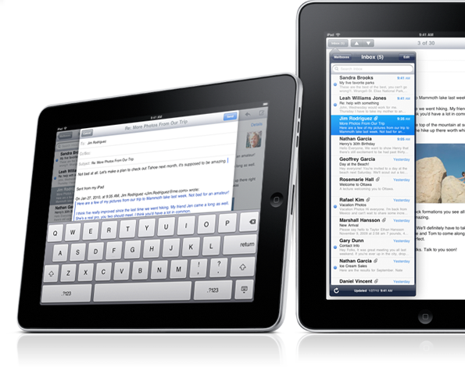
Mobile Devices
Tablets are a disruptor
Screen real estate, power, usability, portability
Replacing traditional devices
E.g., Field engineers replacing high-end GPS units and ruggedized PCs (~$5000) with an iPad (~$800) that has built in GPS and wireless; or United Airlines replacing 34 lbs. of pilot charts (11,000 units)
Cheaper, lighter, more useful
Are disks needed in the future?
Notes:
Flash

Slide 62
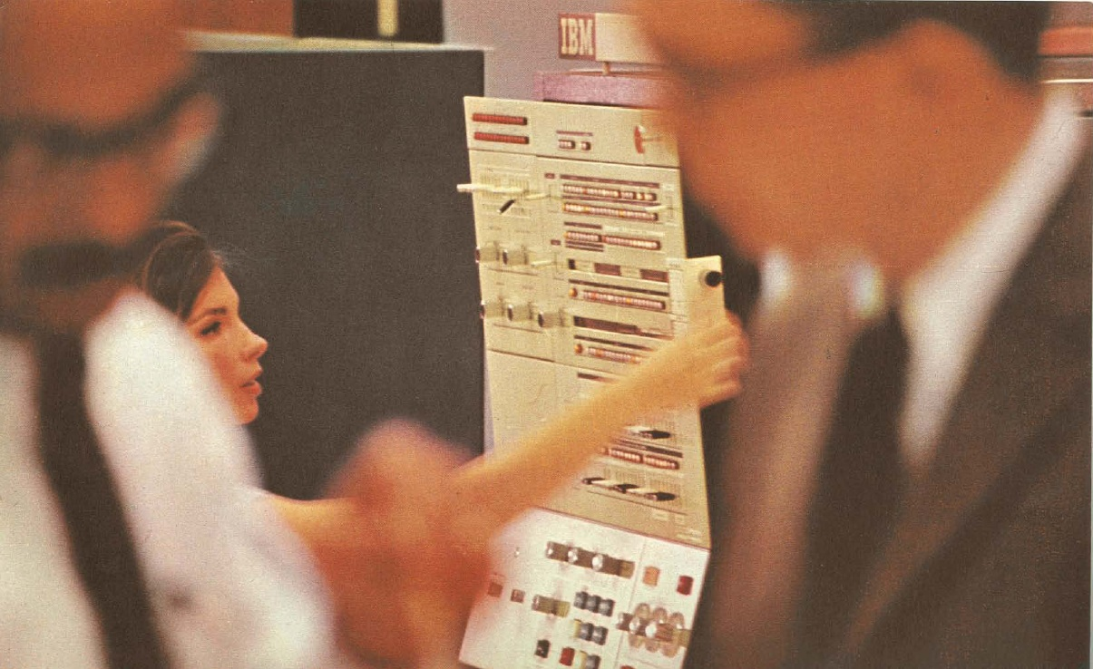
Data Model Design
Geostreaming

Slide 63
Geostreaming
Lots of work during past decade on stream processing
Big, sophisticated systems in place, particularly in financial services/Wall Street and defense/intel
Available commercial frameworks:
Microsoft, Oracle, IBM, StreamBase, Tibco, etc.
Need to extend into spatial domain

Slide 64
Geostreaming
Geoprocessing on geostreams
Collections of geoprocessing functions that can be assembled on geostreams, much like conventional streams and operators/functions
E.g., real-time heat map generation, geofencing,
Detecting abnormal behavior is big topic; e.g.,
Ships at sea (AIS data) – smuggling patterns
Criminals – flash mobs, flocking, evacuation

Slide 65
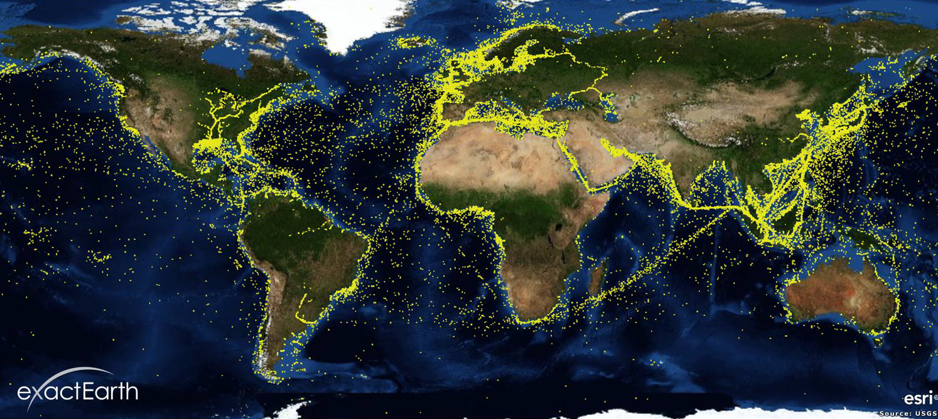
AIS Data
70,000+ ships being tracked (>300T displacement)
Notes:
Broadcast information
An AIS transceiver sends the following data every 2 to 10 seconds depending on a vessel's speed while underway, and every 3 minutes while a vessel is at anchor:
The vessel's Maritime Mobile Service Identity (MMSI) – a unique nine digit identification number.
Navigation status – "at anchor", "under way using engine(s)", "not under command", etc.
Rate of turn – right or left, from 0 to 720 degrees per minute
Speed over ground – 0.1-knot (0.19 km/h) resolution from 0 to 102 knots (189 km/h)
Positional accuracy:
Longitude – to 0.0001 minutes
Latitude – to 0.0001 minutes
Course over ground – relative to true north to 0.1°
True heading – 0 to 359 degrees (for example from a gyro compass)
UTC Seconds – The seconds field of the UTC time when these data were generated. A complete timestamp is not present.
In addition, the following data are broadcast every 6 minutes:
IMO ship identification number – a seven digit number that remains unchanged upon transfer of the ship's registration to another country
Radio call sign – international radio call sign, up to seven characters, assigned to the vessel by its country of registry
Name – 20 characters to represent the name of the vessel
Type of ship/cargo
Dimensions of ship – to nearest meter
Location of positioning system's (e.g., GPS) antenna on board the vessel - in meters aft of bow and meters port of starboard
Type of positioning system – such as GPS, DGPS or LORAN-C.
Draught of ship – 0.1 meter to 25.5 meters
Destination – max. 20 characters
ETA (estimated time of arrival) at destination – UTC month/date hour:minute

Slide 66
Patterns
t₁₉
t₁₈
t₁₇
t₁₆
t₁
t₁₅
t₂
t₃
?
t₄
t₅

Slide 67
Patterns
t₁
t₁₀
t₂
t₉
t₃
t₁
t₂
t₄
t₈
t₇
t₈
t₃
t₇
t₄
t₆
t₅
t₆
t₅
t₉
t₁₀
t₁₁

Slide 68
Patterns
t₁
t₁₀
t₂
t₉
t₃
t₁
?
t₂
t₄
t₈
t₇
t₈
t₃
t₇
t₄
t₆
t₅
t₆
t₅
t₉
t₁₀
t₁₁

Slide 69
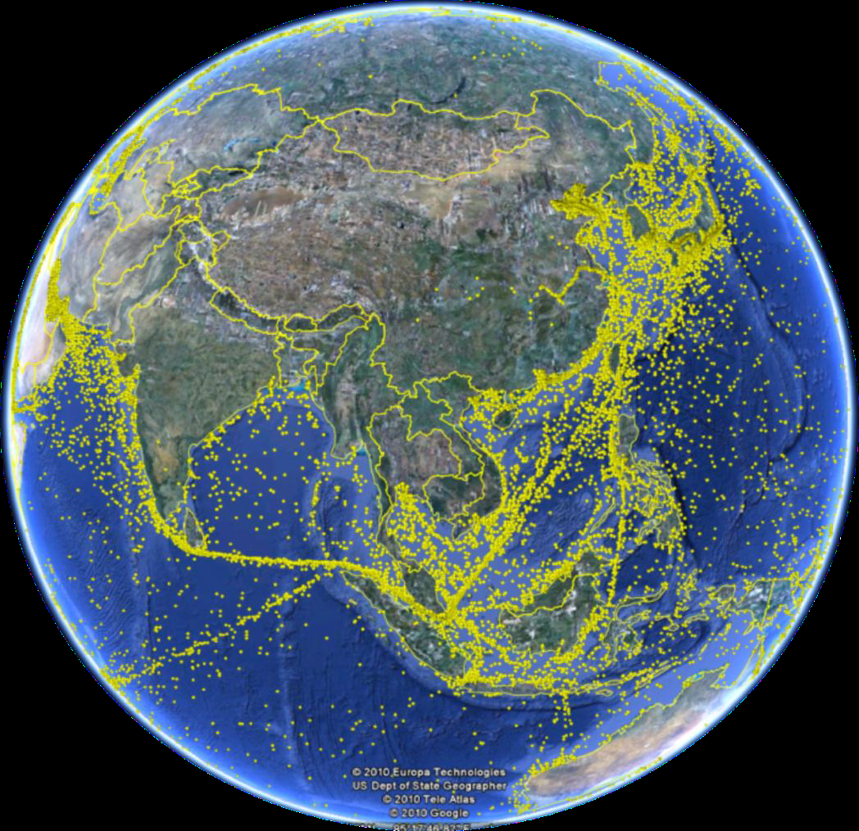
Patterns
Many interesting patterns:
Moving too slowly (engine problems)
Moving too quickly in bad weather (safety)
Stoppages (accidents)
Stoppages, then moving quickly (repairs)
Orbiting, scan line patterns (fishing)

Slide 70
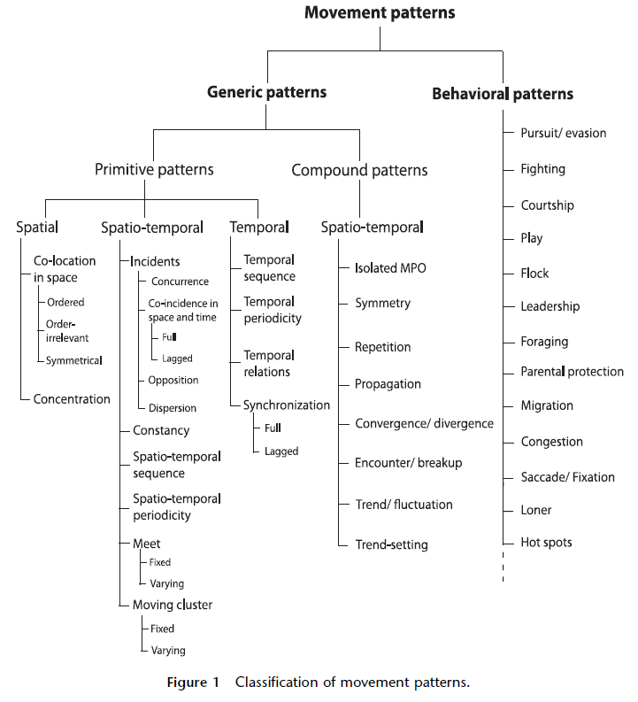
Patterns

Slide 71
Patterns

Slide 72
Sensor Networks
Maintain real-time databases
Specialized forms exist
E.g., weather, air traffic control, traffic loops, SOSUS, electric power distribution (SCADA, Smart Grid, AMI)
Very difficult and expensive to implement; very custom functionality

Slide 73
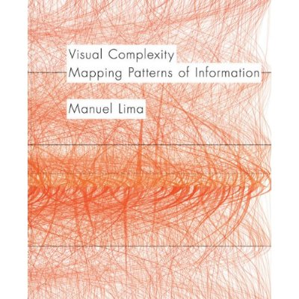
Visualization
Non-spatial data visualization challenging
Social networks, telco circuits
Derived geometry based upon containment
Schematic representations
Manuel Lima’s Visual Complexity is today’s Tufte for non-spatial visualization

Slide 74
Procedural
Procedural definitions
Polynomial with coefficients describing 3D solids
ParallelGeometry (Quebec)
Procedural descriptions of houses and buildings
<CityEngine video>

Slide 75
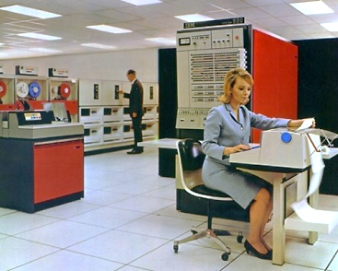
Dynamic GIS

Slide 76
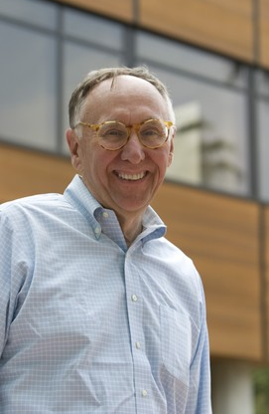
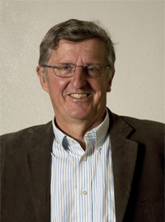
Dynamic GIS
Managing dynamic knowledge
Most observations are about a point or a line or a polygon, not their interaction with other points, lines, and polygons
Pairs of places and the dynamics that happen between them
Related to social networking problems
Dangermond Goodchild

Slide 77
Dynamic GIS
“Pairs of places" involves:
Proximity and flows
Interactions in time and space – e.g., migrations
Display of complex interactions like communications that occur in a social network
“Pairs of classes" and their interactions and the ability to link facts at a point to other facts
What's happening at one location is related to what's happening at other points, both in the spatial and temporal dimensions

Slide 78
Dynamic GIS
Need to look at spatio-temporal patterns and infer something about the processes that are going on
Can be done best visually with maps, where things like footprints lead to inferences about a pattern
E.g., flash mobs, flocking, cotravelor, etc.
Over time, we've attempted to build these kinds of relationships like point and polygon, polygon overlay, and other geometric static relationships and space

Slide 79
Dynamic GIS
We have not invented ways to look at spatial interaction, using pairs of things in time like how many phone calls are being made between multiple cars moving in time and space
This is basically what people are after today when they're wanting to analyze social networks and community interactions …
A new kind of GIS

Slide 80
Dynamic GIS
Dynamic GIS is a paradigm for GIS that enables continuous processing of spatial information to deliver temporally relevant map and analysis outputs

Slide 81
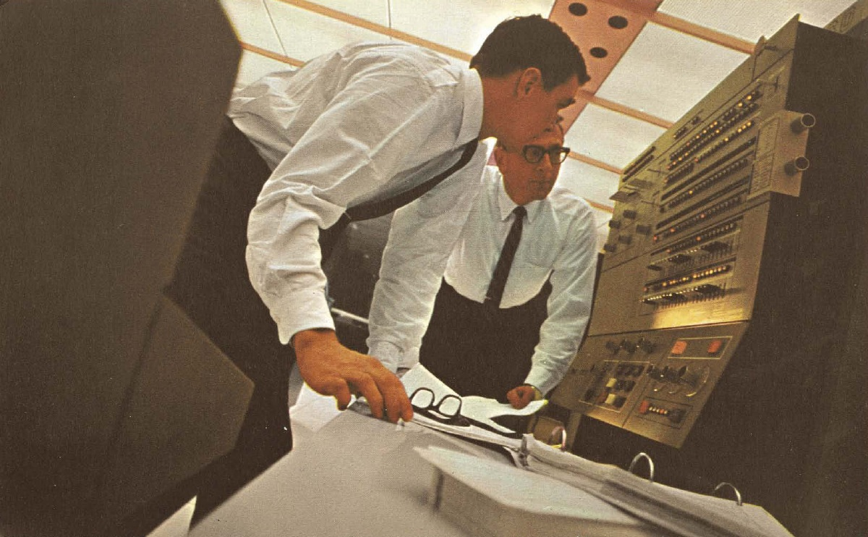
Final Observations

Slide 82
Final Observations
Focus on disruptive technology
Too much delta (and epsilon) research
Workflow based research
Solve useful problems that you could explain to your mom
Don’t try to develop the grand unification theory
E.g., procedural / rule-based construction of only buildings and roads, not everything

Slide 83
Final Observations
How can we take science and make it really easy?
Universe is changing; rise of the Neo-Geos
Very difficult for everyone
How can you make bad data good?

Slide 84
Final Observations
Inject some pragmatic engineering
Use real databases (open source/web-based/whatever)
Simple scales, complex fails
Precompute as if your life depends upon it
Significant performance advantages may be gained if reasonable constraints may be made
Disk space cheap, as is hardware running in background

