Slide 1
Towards Reducing Taxicab Cruising Time Using Spatio-Temporal Profitability Maps
Jason Powell, Yan Huang, Favyen Bastani and Minhe Ji
Department of Computer Science and Engineering
University of North Texas
And
Department of Geography
East China Normal University

Slide 2
Agenda
Introduction
Contributions
Related Work
STP Map Methodology
Shanghai Taxi Case Study
Validation
Future Work
Conclusion

Slide 3
Introduction
Taxicab service provides a vital role in public transportation
Higher transportation costs, lower budgets
Live miles – miles with a customer
Cruising miles – miles without a customer
35-60% of time is cruising miles
Cruising taxi service does not lend itself to systematic routing

Slide 4
Introduction
Problem: How to simultaneously reduce cruising miles while increasing live miles without systematic routing.
Solution: The Spatio-Temporal Profitability (STP) Maps Framework
Uses taxi driver experiences through historical taxicab GPS data to find profitable locations
Assigns profitability scores to the locations
Personalized it to the taxi using location and time

Slide 5
Contributions
A framework that uses historical GPS data to model potential profitability given current location and time.
A framework that provides personalized suggestions to taxi drivers.
A demonstration of effectiveness and validation using Shanghai taxicab GPS traces.

Slide 6
Related Work
Two categories of taxi service
Dispatching – specified locations given ahead of time
Cruising – travel the road network looking for a fare
Research commonly involves routing but not profitability
2008: Yamamoto, et al. – dynamic routing and path sharing among taxicabs
2009: Wang – Shift Match Algorithms to reduce cruising time during dispatch service
2010: Yuan, et al. – Fastest routes based on historical GPS trajectories
2010: Ge, et al. – Probability route suggestions

Slide 7
STP Map Methodology
Conceptual Overview
Current location and time are parameters for querying historical data
The data becomes profitability scores for locations around the taxicab
The profitability scores are assembled into an STP Map and given to the taxicab driver

Slide 8
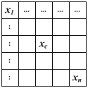
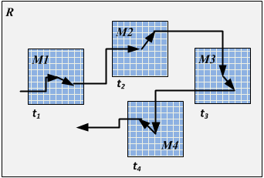
STP Map Methodology
Define a region M around the taxi’s location for short-term planning
Divide the region into cells
Assign a profitability score to each cell
Assemble the cells into a map
Provide the map to the taxicab driver
Repeat at the beginning of each cruise trip

Slide 9
STP Map Methodology
Profitability score
Base on a generalized taxi fare formula
Converted to time since time represents profit
Inherently captures probability
Considers costs associated with reaching the cell

Slide 10
STP Map Methodology
Delayed Experience Window (DEW)
A window of historical data for a cell
Begins when the taxicab will reach a cell
Should be a reasonable size
Too large – includes data not representative of the period
Too small – does not include enough data

Slide 11
Shanghai Taxi Case Study
Shanghai – 45,000+ taxis, 150 taxi companies
Complete dataset
May 29, 2009, 12am – 6pm
17,139 taxis, 3 companies
48.1+ million GPS records
468,000 live trips
Experimental data subset
First company – 7,226 taxis
Region limited to 31.0-31.5° N, 121.0-122.0° E
Trips between 5 minutes and 3 hours
144,000+ live trips, 143,000+ cruising trips
A data set?
A set of Datas.

Slide 12
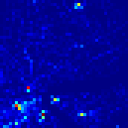
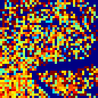
Shanghai Taxi Case Study
Downtown Shanghai, 1pm, M = 67.2 km², 60 minute DEW, 190.5-meter cell length
STP Map
Live Trip Counts
Live Trip Probability

Slide 13
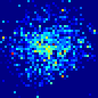
Shanghai Taxi Case Study
Each taxi receives a unique STP Map
STP Map 1
STP Map 2
Over lapping regions of two taxis at different locations but same times.

Slide 14
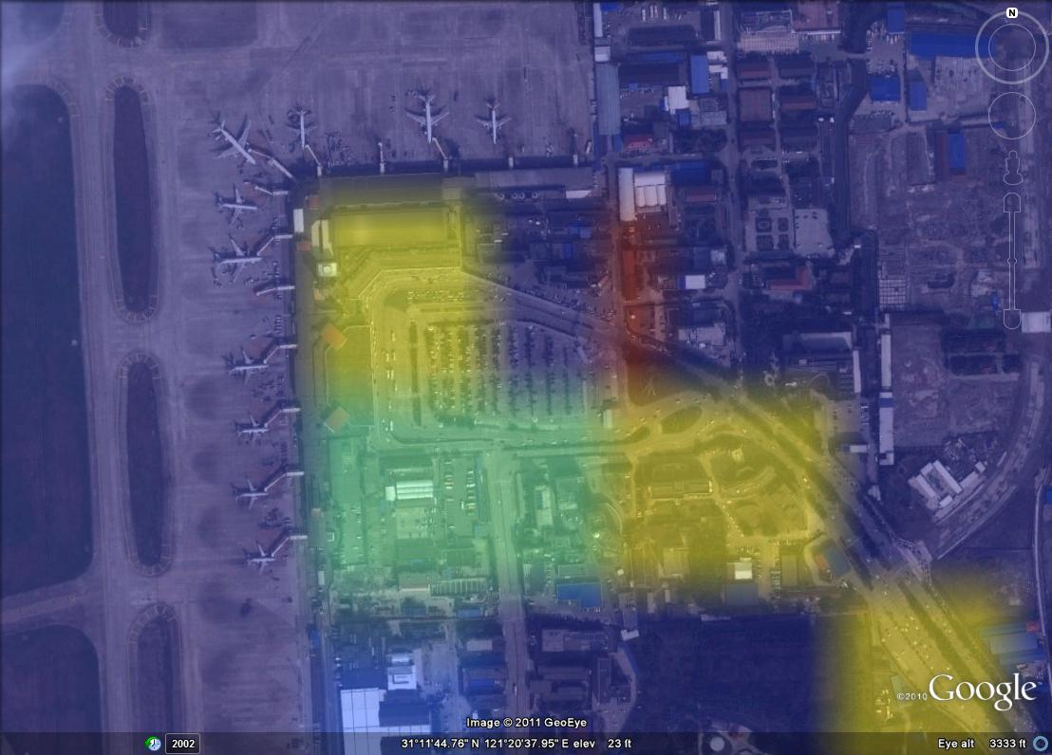
Shanghai Taxi Case Study

Slide 15
Validation
STP Map correlation with actual profitability
Assume taxi drivers cruise towards highly profitable locations
If true, ending locations of cruising trips are highly profitable locations
Therefore, if these locations correlate to our STP maps, then the STP maps correctly suggest profitable locations

Slide 16
Validation
Five subsets with 516-539 taxis per set
At least 19 trips per taxi
Followed their paths throughout the day
Generated an STP maps for each cruise trip
Started with 15 minute DEW, 15.8 km², 95-meter
Hit Profit – Sum of profitability scores of locations at the end of cruising trips
Compared Hit Profit to Live Time/Total Time

Slide 17
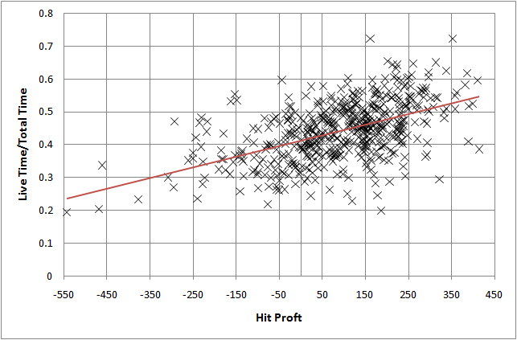
Validation – Results
Example correlation results using cell size 190x190 m² with a 30-minute DEW that shows the upward trend in correlation between actual profitability and the STP Maps

Slide 18
Future Work
Using temporal patterns to adjust parameters
Use alternatives to Manhattan and Euclidean distances
Use the road network, current traffic conditions, and obstacles, and/or common taxi paths
Create profitability routes using a series of STP maps
Fully develop a real-time system for taxicabs

Slide 19
Conclusion
Taxicab service is inefficient and routing is difficult
STP Map framework
Suggests profitable locations
Does not require routing
Uses historical spatio-temporal data
Customized to the taxicab
Demonstrated with Shanghai Taxis
Validated through correlation with actual profitability

Slide 20
References
[1] Schaller Consulting: The New York City Taxicab Fact Book, Schaller Consulting, Brooklyn, NY, 2006, available at http://www.schallerconsult.com/taxi/taxifb.pdf
[2] Yamamoto, K., Uesugi, K., and Watanabe, T.: Adaptive Routing of Cruising Taxis by Mutual Exchange of Pathways, Knowledge-Based Intelligent Information and Engineering Systems, 5178 (2008) 559–566
[3] Li, Q., Zeng Z., Bisheng, Y., and Zhang, T.: Hierarchical route planning based on taxi GPS-trajectories, 17th International Conference on Geoinformatics (Fairfax, 2009), pp. 1–5
[4] Wang, H.: The Strategy of Utilizing Taxi Empty Cruise Time to Solve the Short Distance Trip Problem, Masters Thesis, The University of Melbourne, 2009
[5] Cheng, S. and Qu, X.: A service choice model for optimizing taxi service delivery, 12th International IEEE Conference on Intelligent Transportation Systems, ITSC ’09 (St. Louis, 2009), pp. 1–6
[6] Phithakkitnukoon, S., Veloso, M., Bento, C., Biderman, A., and Ratti, C.: Taxi-aware map: identifying and predicting vacant taxis in the city, Proceedings of the First international joint conference on Ambient intelligence, AmI’10 (Malaga, 2010), pp. 86–95
[7] Hong-Cheng, G., Xin, Y., and Qing, W.: Investigating the effect of travel time variability on drivers’ route choice decisions in Shanghai, China, Transportation Planning and Technology, 33 (2010) 657–669
[8] Li, Y., Miller, M.A., and Cassidy, M.J., Improving Mobility Through Enhanced Transit Services: Transit Taxi Service for Areas with Low Passenger Demand Density, University of California, Berkeley and California Department of Transportation, 2009.
[9] Cooper, J., Farrell, S., and Simpson, P.: Identifying Demand and Optimal Location for Taxi Ranks in a Liberalized Market, Transportation Research Board 89th Annual Meeting (2010)

Slide 21
References
[10] Sirisoma, R.M.N.T., Wong, S.C., Lam, W.H.K., Wang, D., Yan, H., and Zhang, P.: Empirical evidence for taxi customer-search model, Transportation Research Board 88th Annual Meeting, 163 (2009) 203–210
[11] Yang, H., Fung, C.S., Wong, K.I., Wong, S.C.: Nonlinear pricing of taxi services, Transportation Research Part A: Policy and Practice, 44 (2010) 337–348
[12] Chintakayala, P., and Maitra, B., Modeling Generalized Cost of Travel and Its Application for Improvement of Taxies in Kolkata, Journal of Urban Planning and Development, 136 (2010) 42–49
[13] Wikipedia, Shanghai — Wikipedia, The Free Encyclopedia, 2011, Online; accessed 21-May-2011, http://en.wikipedia.org/w/index.php?title=Shanghai&oldid=412823222
[14] TravelChinaGuide.com, Get Around Shanghai by Taxi, Shanghai Transportation, 2011, Online; accessed 9-February-2011, http://www.travelchinaguide.com/cityguides/shanghai/transportation/taxi.htm
[15] Shanghai Taxi Cab Rates and Companies, Kuber, 2011, Online; accessed 9-February-2011, http://kuber.appspot.com/taxi/rate
[16] Yuan, Jing and Zheng, Yu and Zhang, Chengyang and Xie, Wenlei and Xie, Xing and Sun, Guangzhong and Huang, Yan, T-drive: driving directions based on taxi trajectories, Proceedings of the 18th SIGSPATIAL International Conference on Advances in Geographic Information Systems, GIS ’10 (San Jose, 2010), pp. 99–108
[17] Ge, Yong and Xiong, Hui and Tuzhilin, Alexander and Xiao, Keli and Gruteser, Marco and Pazzani, Michael, An energy-efficient mobile recommender system, Proceedings of the 16th ACM SIGKDD international conference on Knowledge discovery and data mining, KDD ’10 (Washington, DC, 2010), pp. 899–908

